Slide 1
Power BI

Slide 2
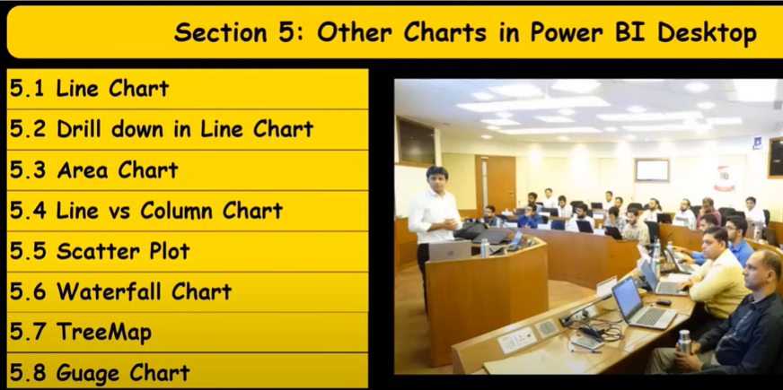

Slide 3
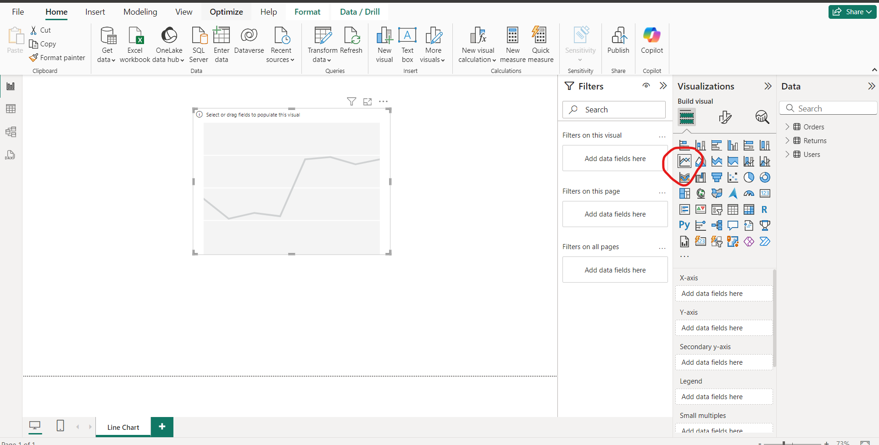
Line Chart-1

Slide 4
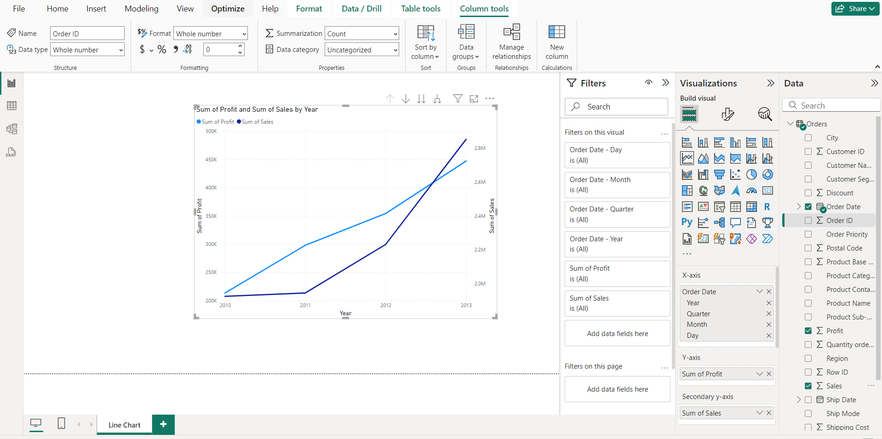
Line Chart-2

Slide 5
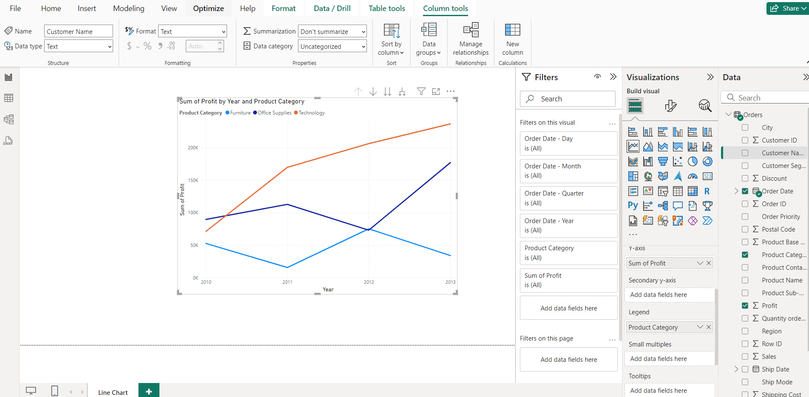
Line Chart- Legend

Slide 6
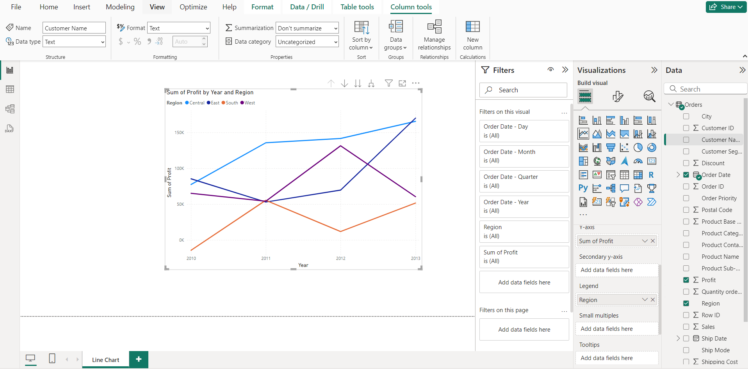
Line Chart- Region wise Profit (Legend)

Slide 7
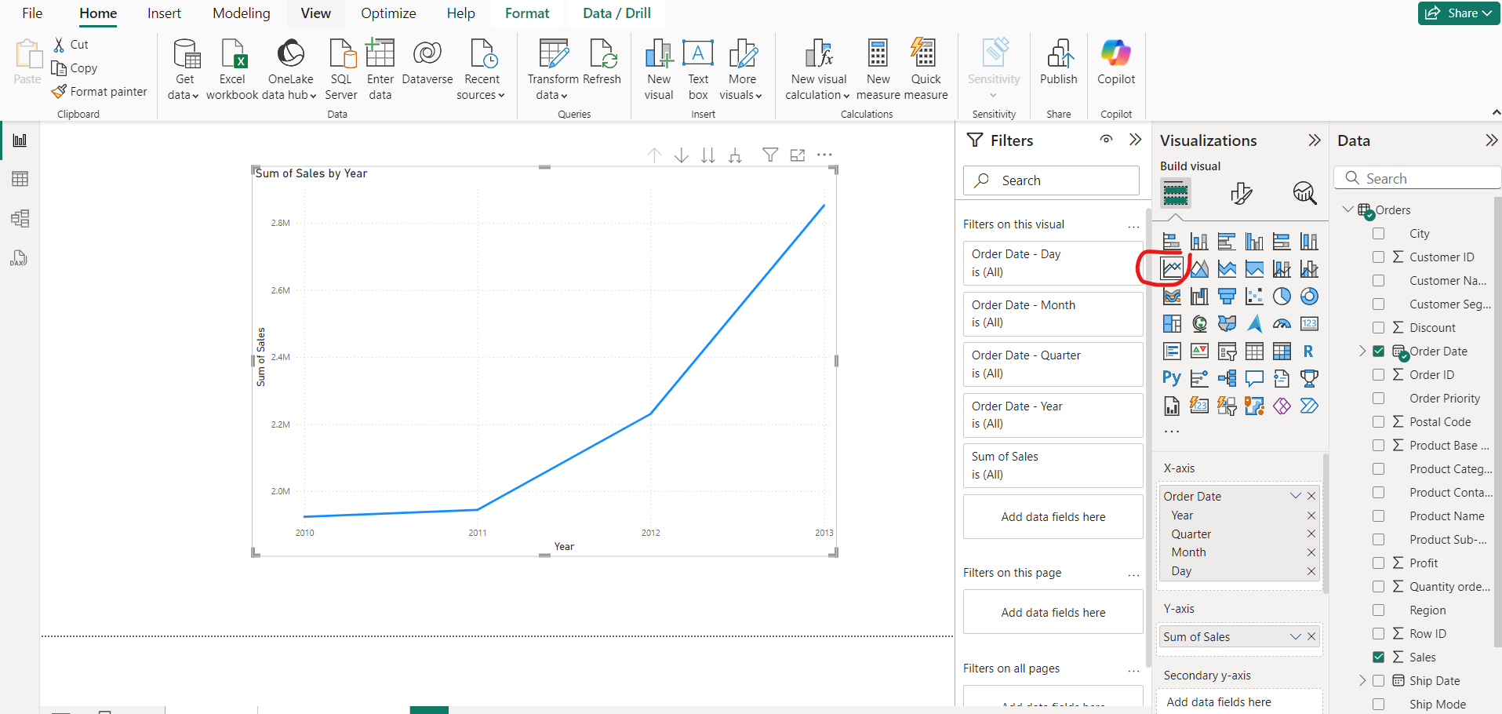
Drill Down Line Chart

Slide 8
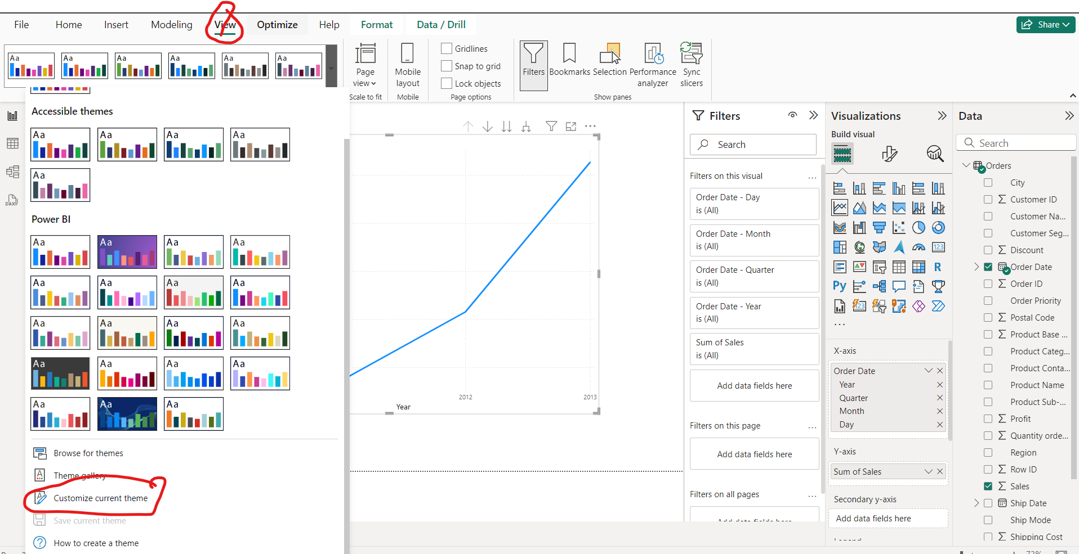
Customize Font

Slide 9
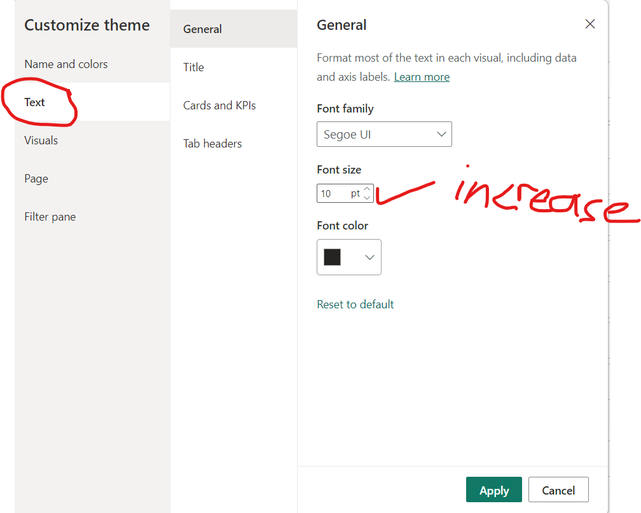
Increase font

Slide 10
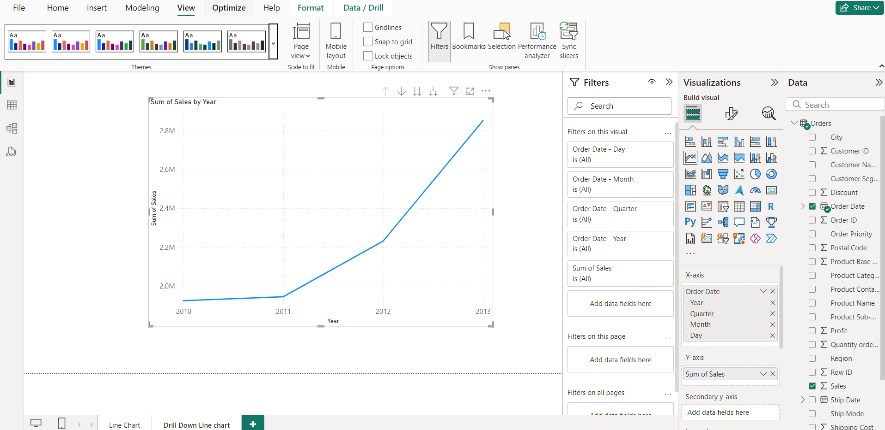
Increased Font visuals

Slide 11
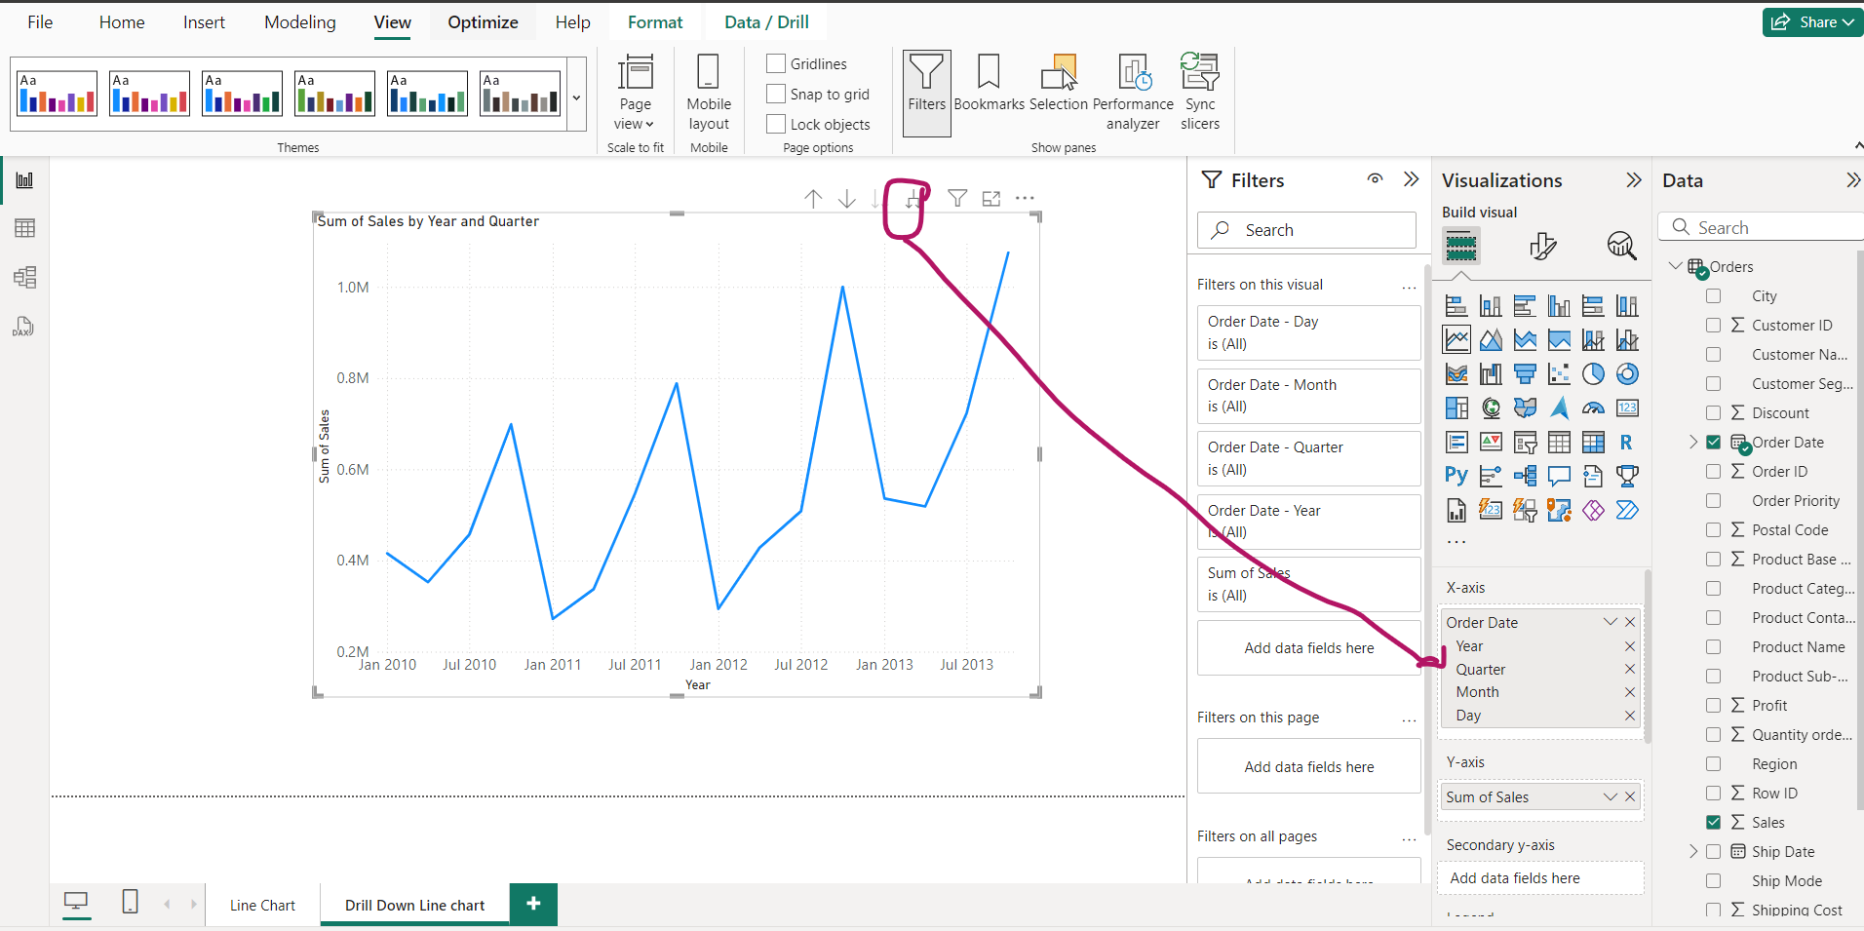
Drill Down Hierarchy

Slide 12
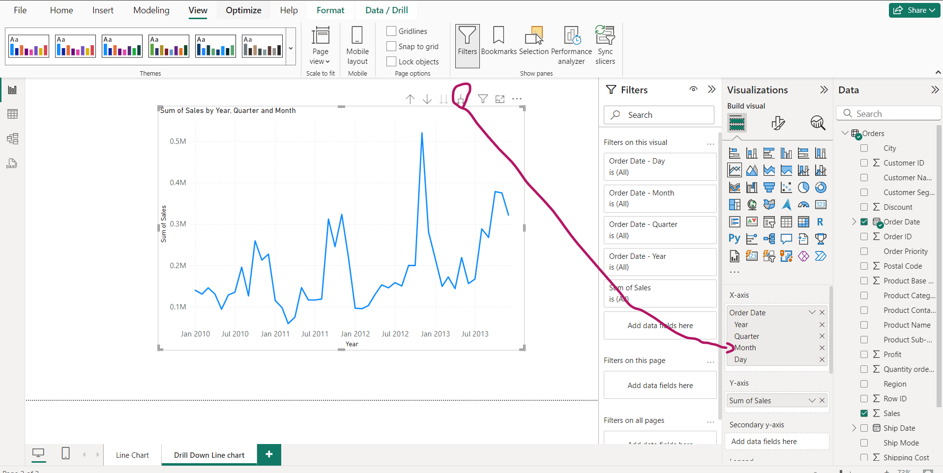
Drill down more to get Monthly info

Slide 13
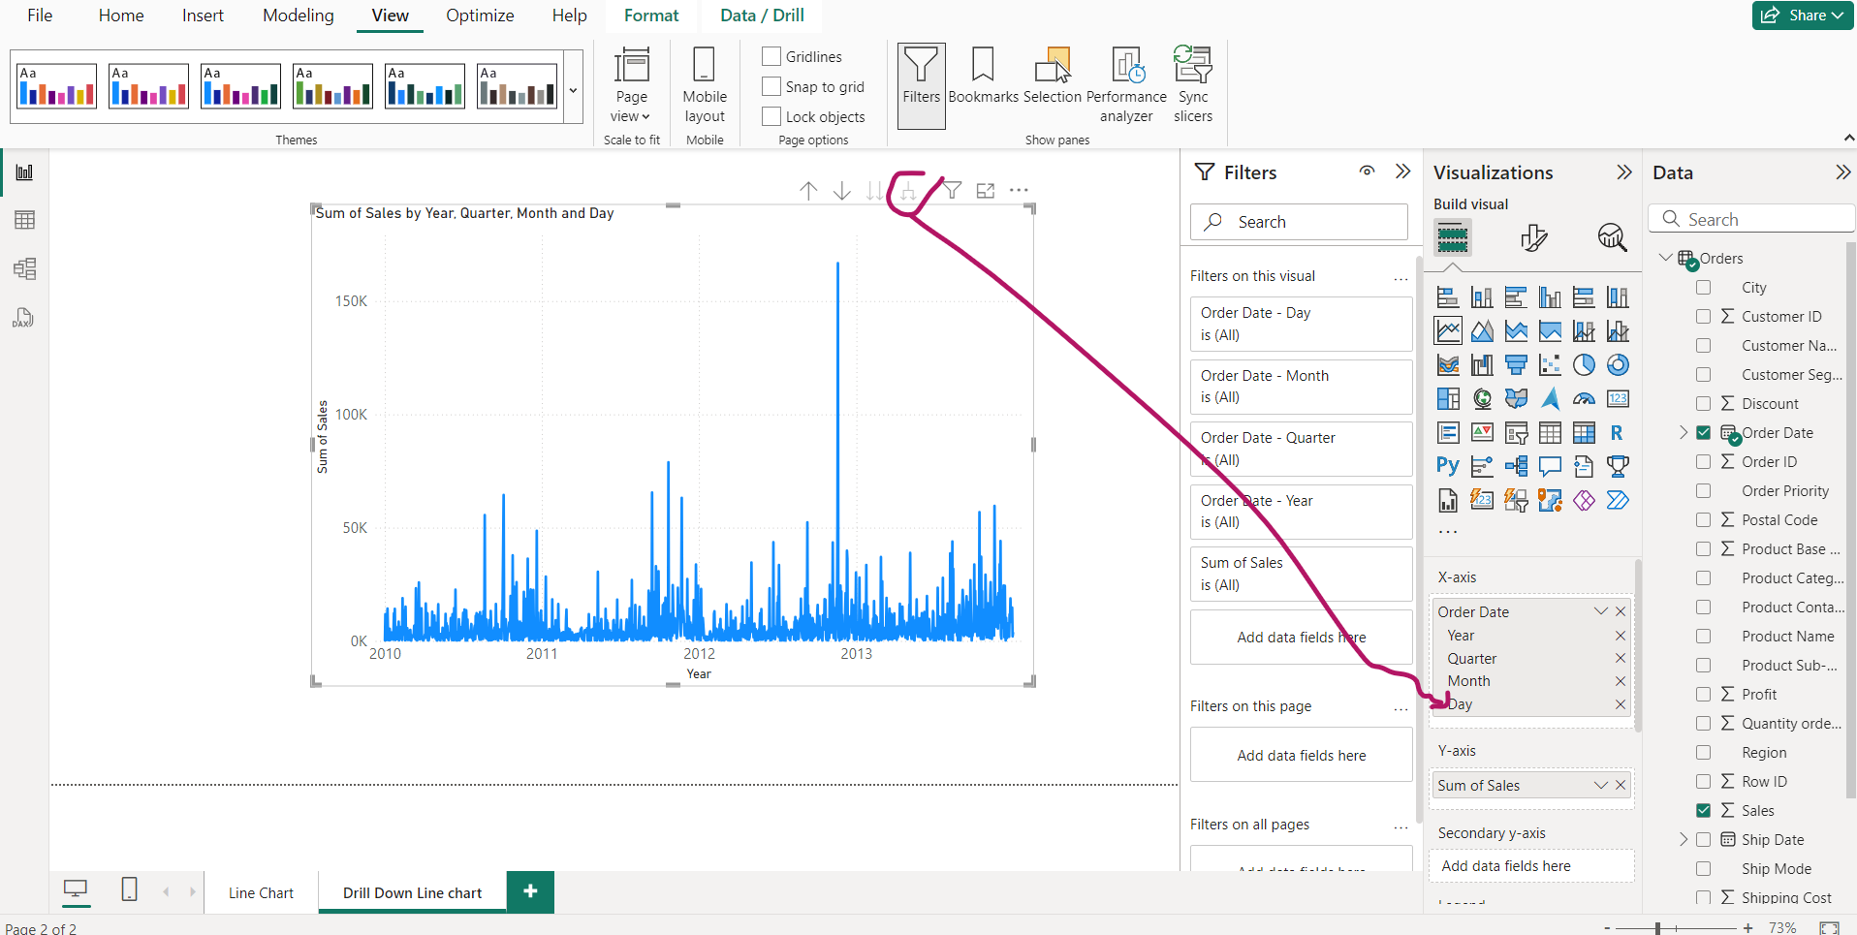
Drill down more to get days too- created a mess??

Slide 14
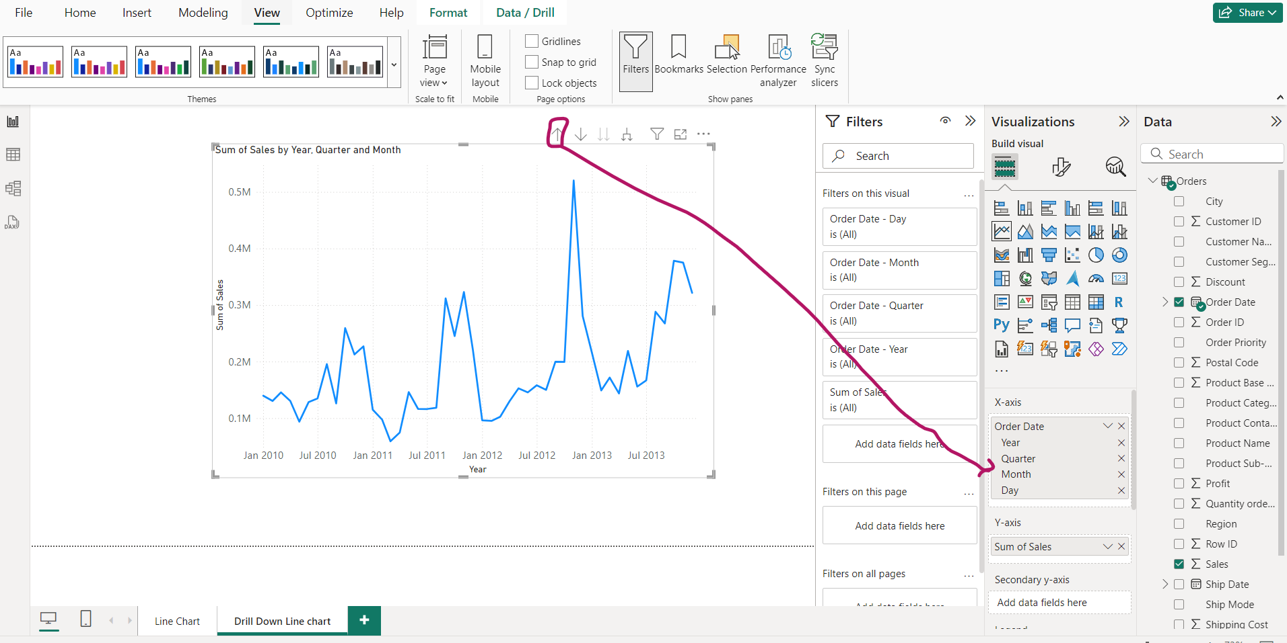
Drill Up as many times as you want info

Slide 15
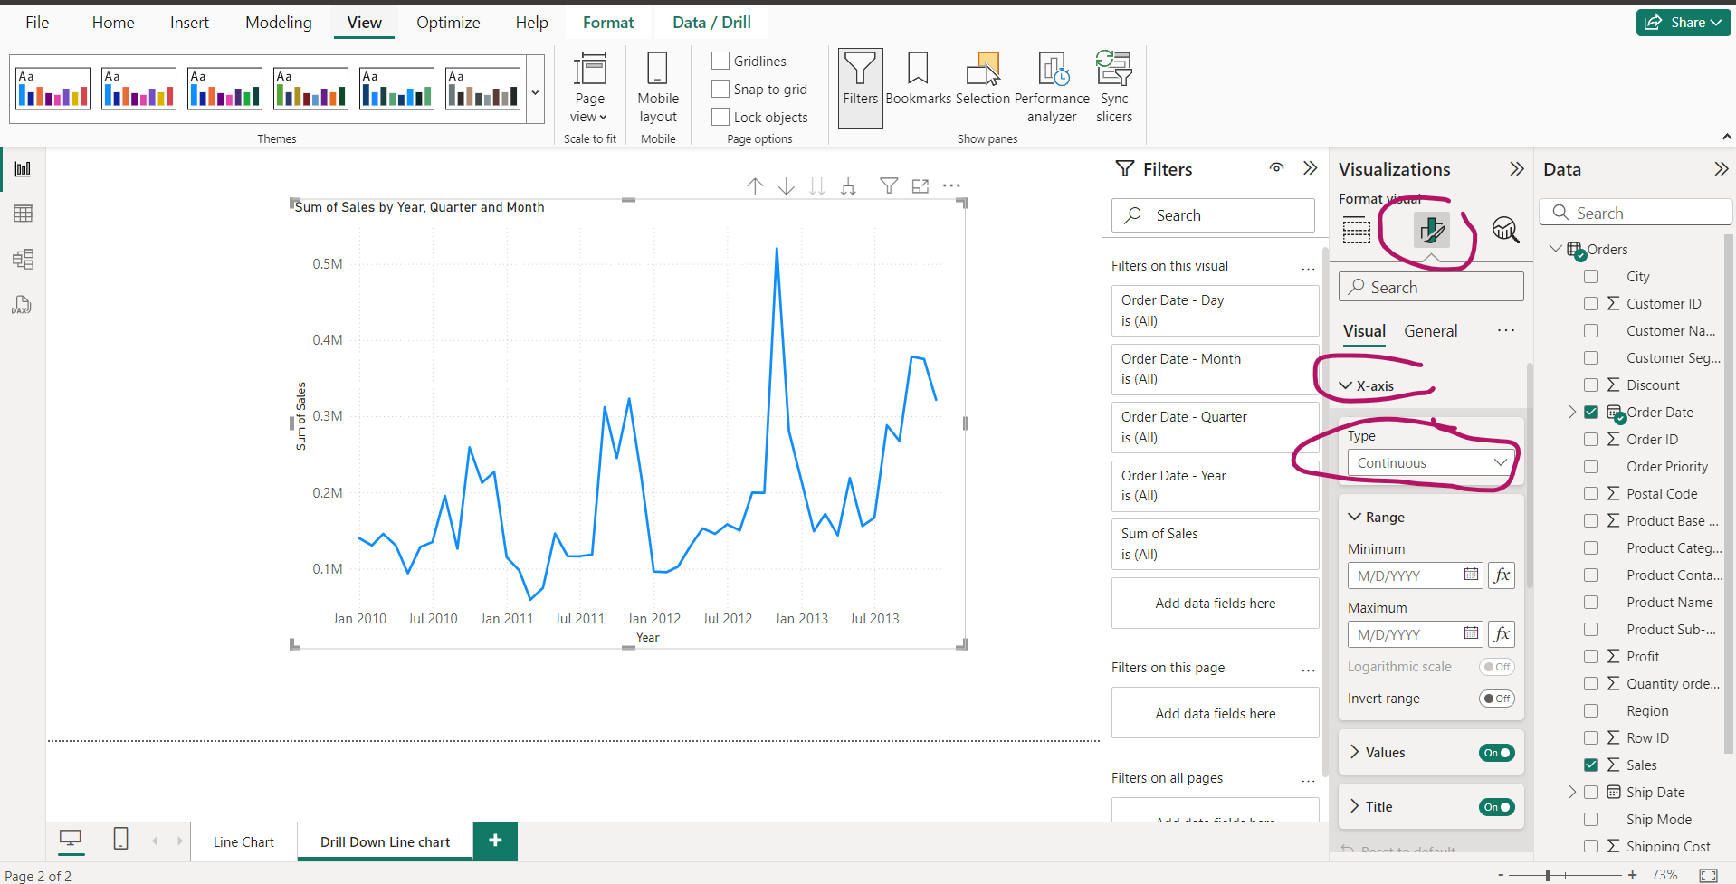
Format the line chart

Slide 16
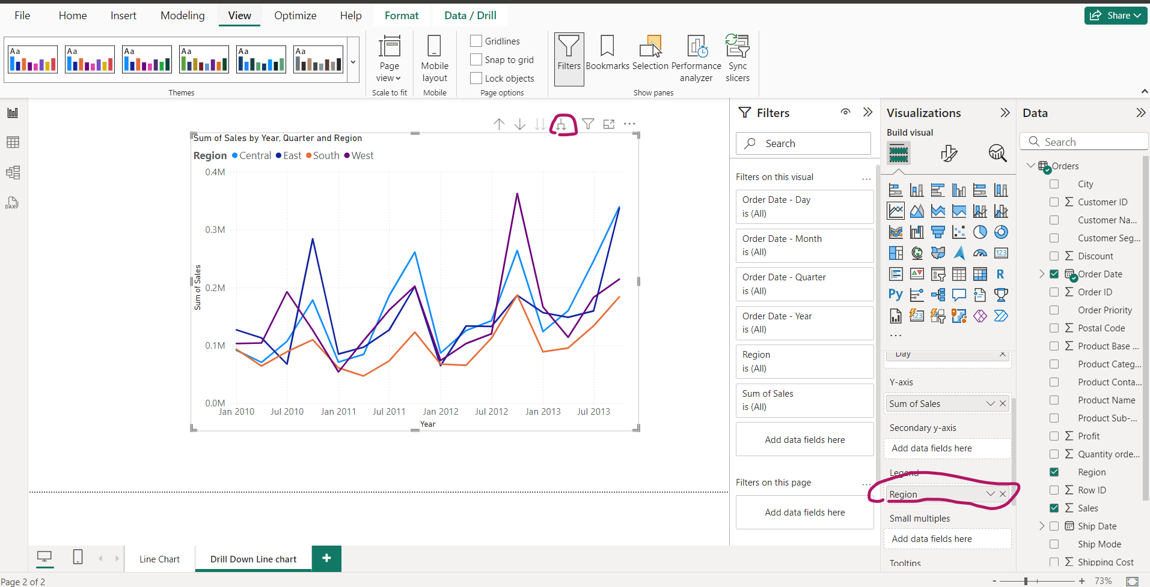
Region wise sale-Drill down to Quarters

Slide 17
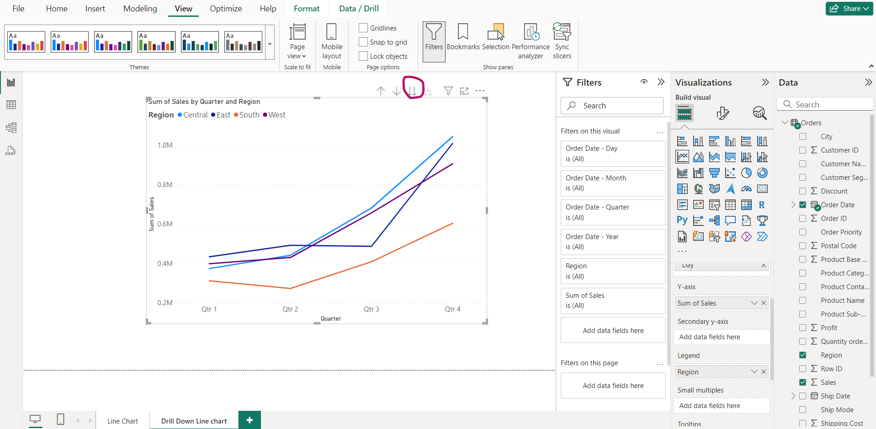
Only Quarter, Only Months, Only days Wise Line chart

Slide 18
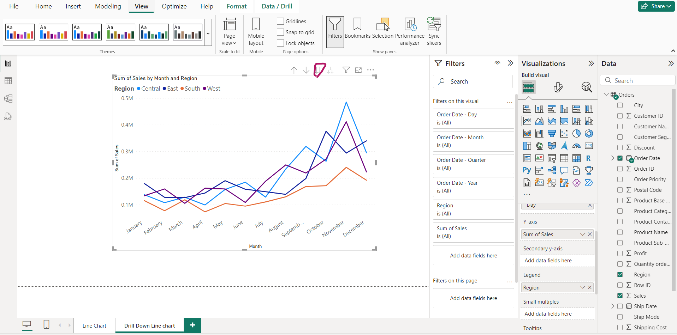
Only Months wise Line chart and so on

Slide 19
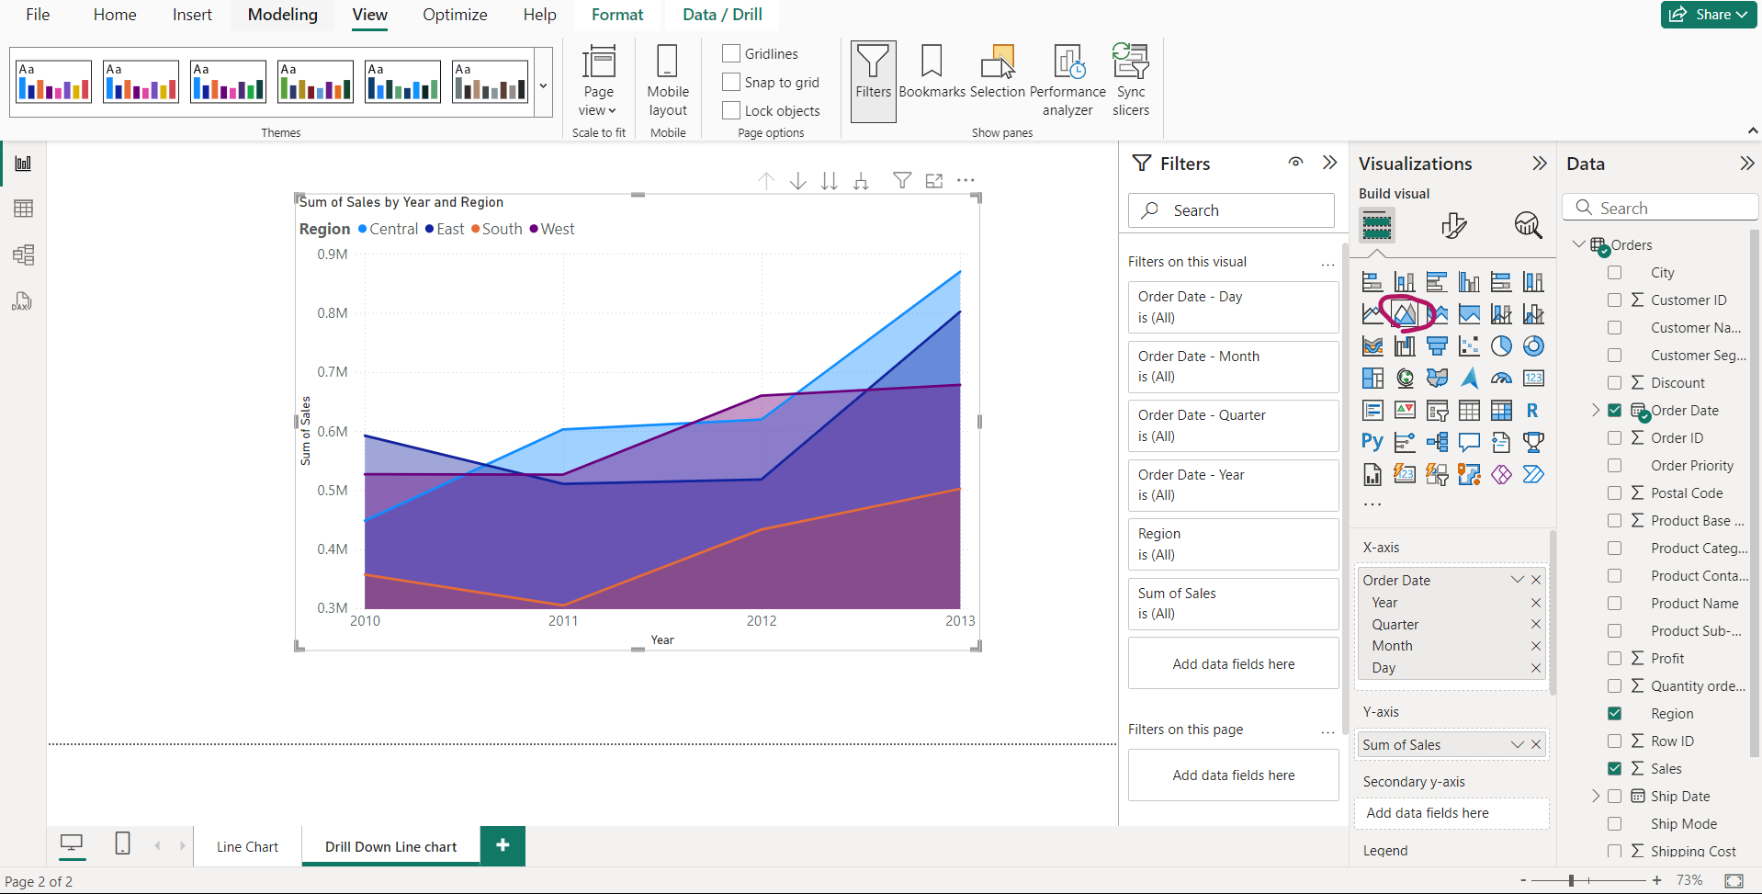
Area Chart- Convert Line chart into Area Chart

Slide 20
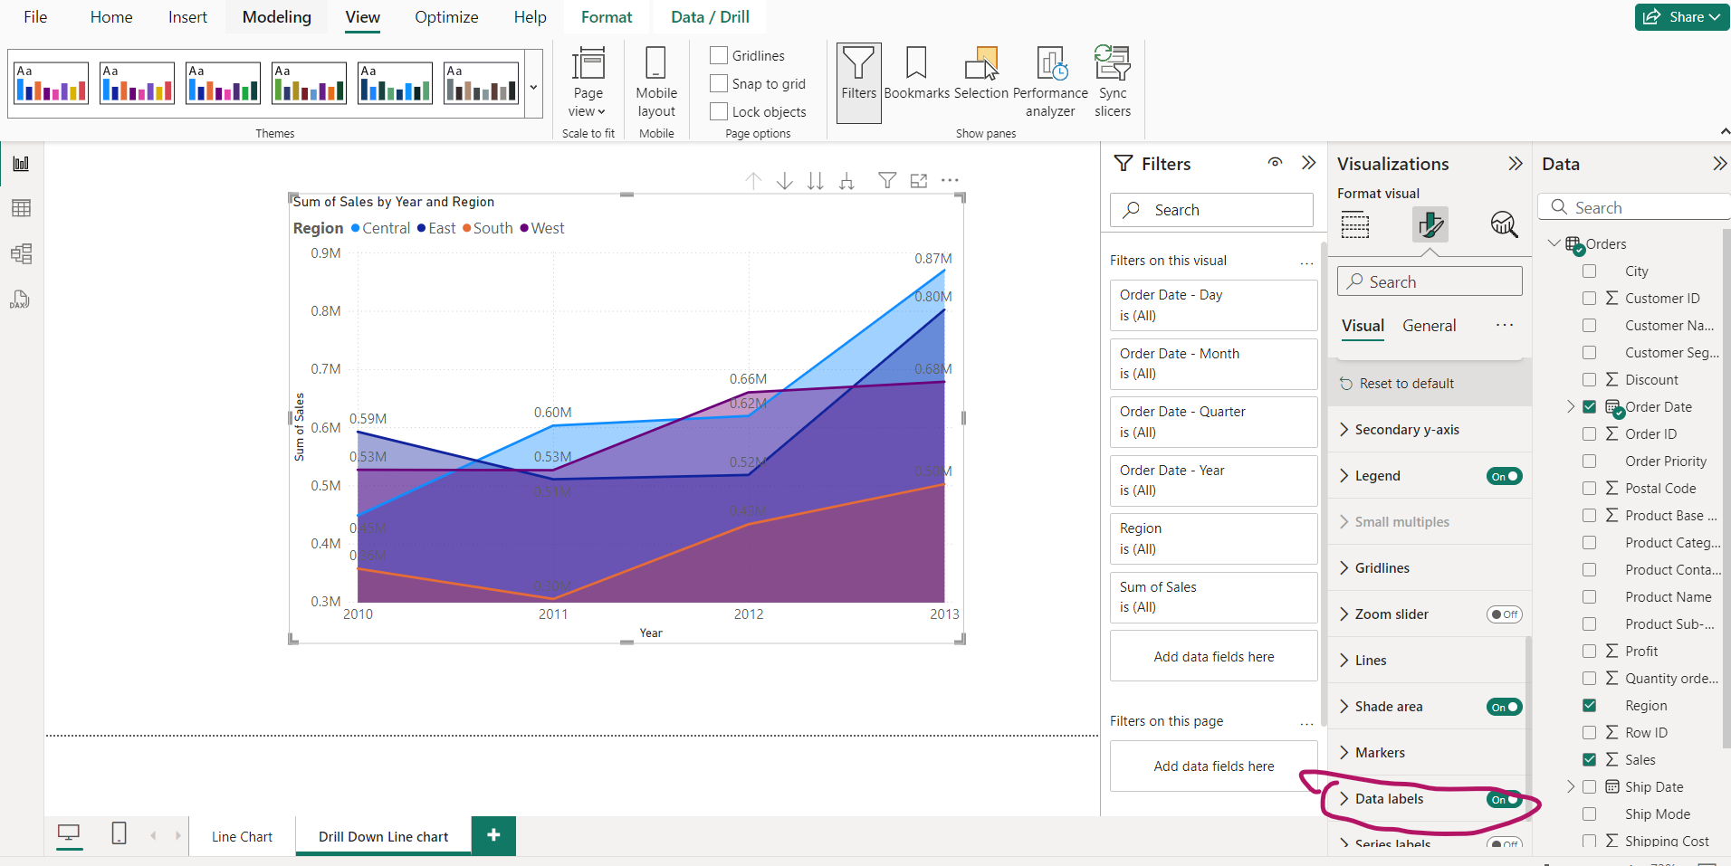
Area Chart-Enable Data Labels

Slide 21
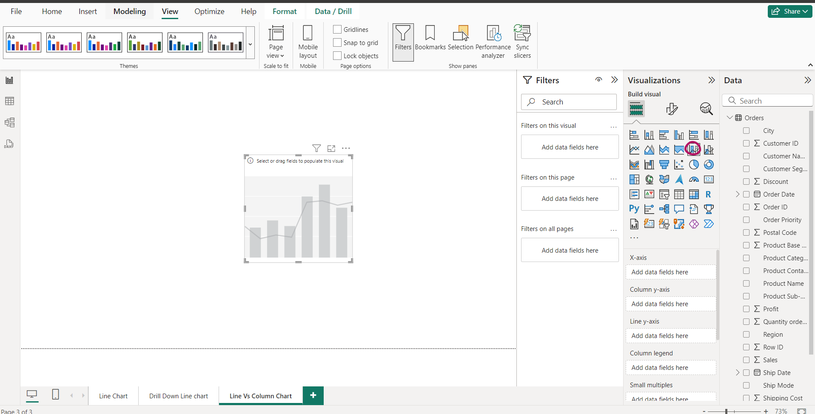
Line Vs Stacked Column Chart

Slide 22
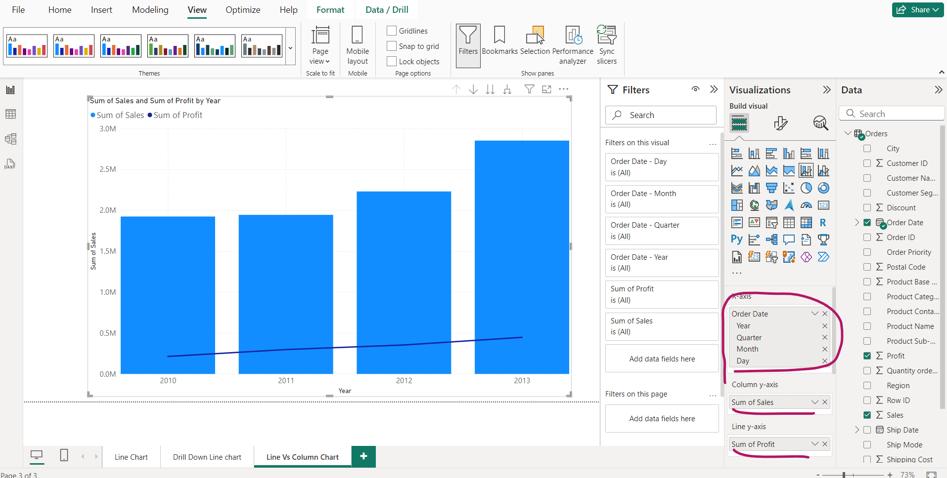
Line vs Stacked column chart- Profit vs Sales

Slide 23
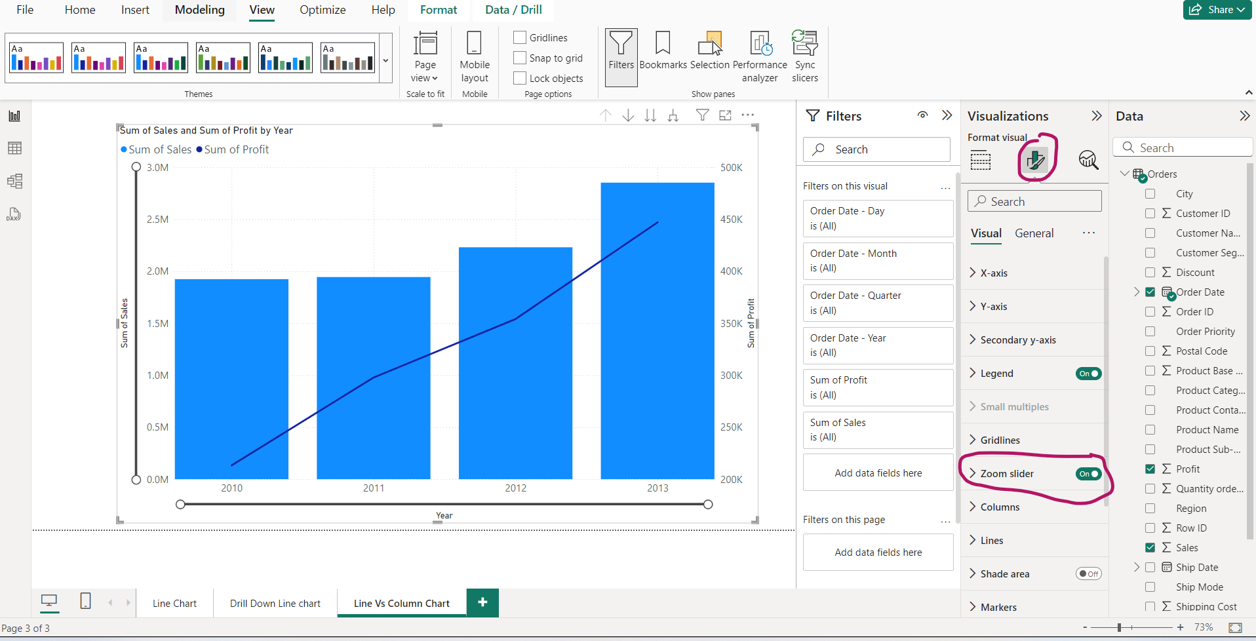
Line vs Stacked Column- Activate zoom slider

Slide 24
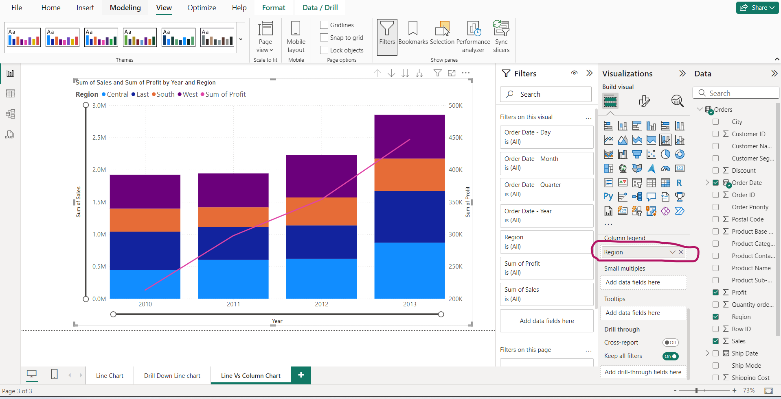
Line vs Stacked Column- Region wise

Slide 25
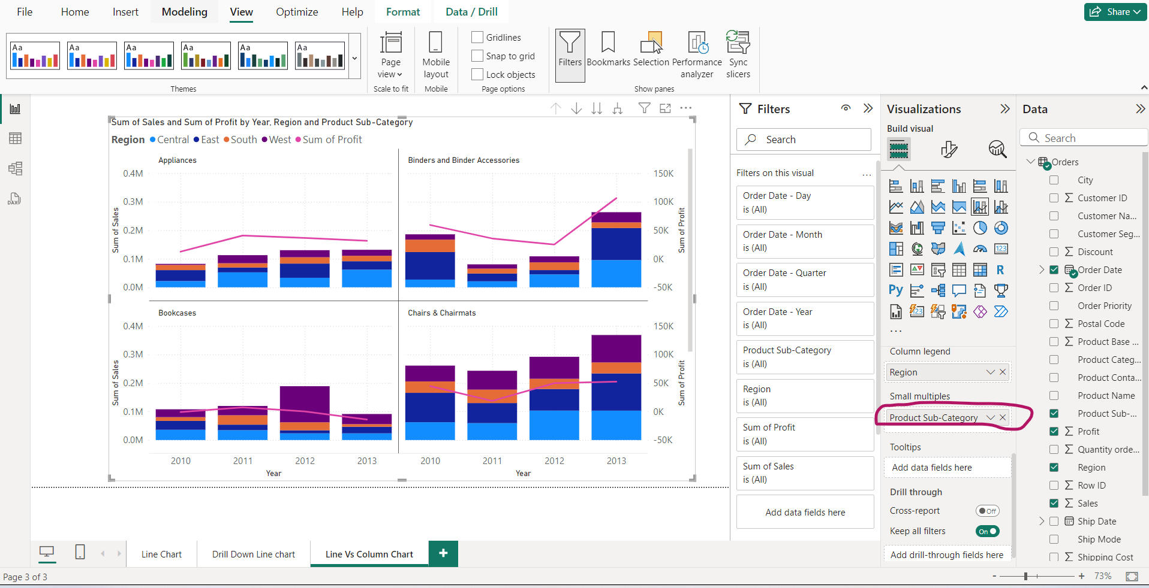
Line vs Stacked Column Chart- Small multiples Sub-category and region distribution

Slide 26
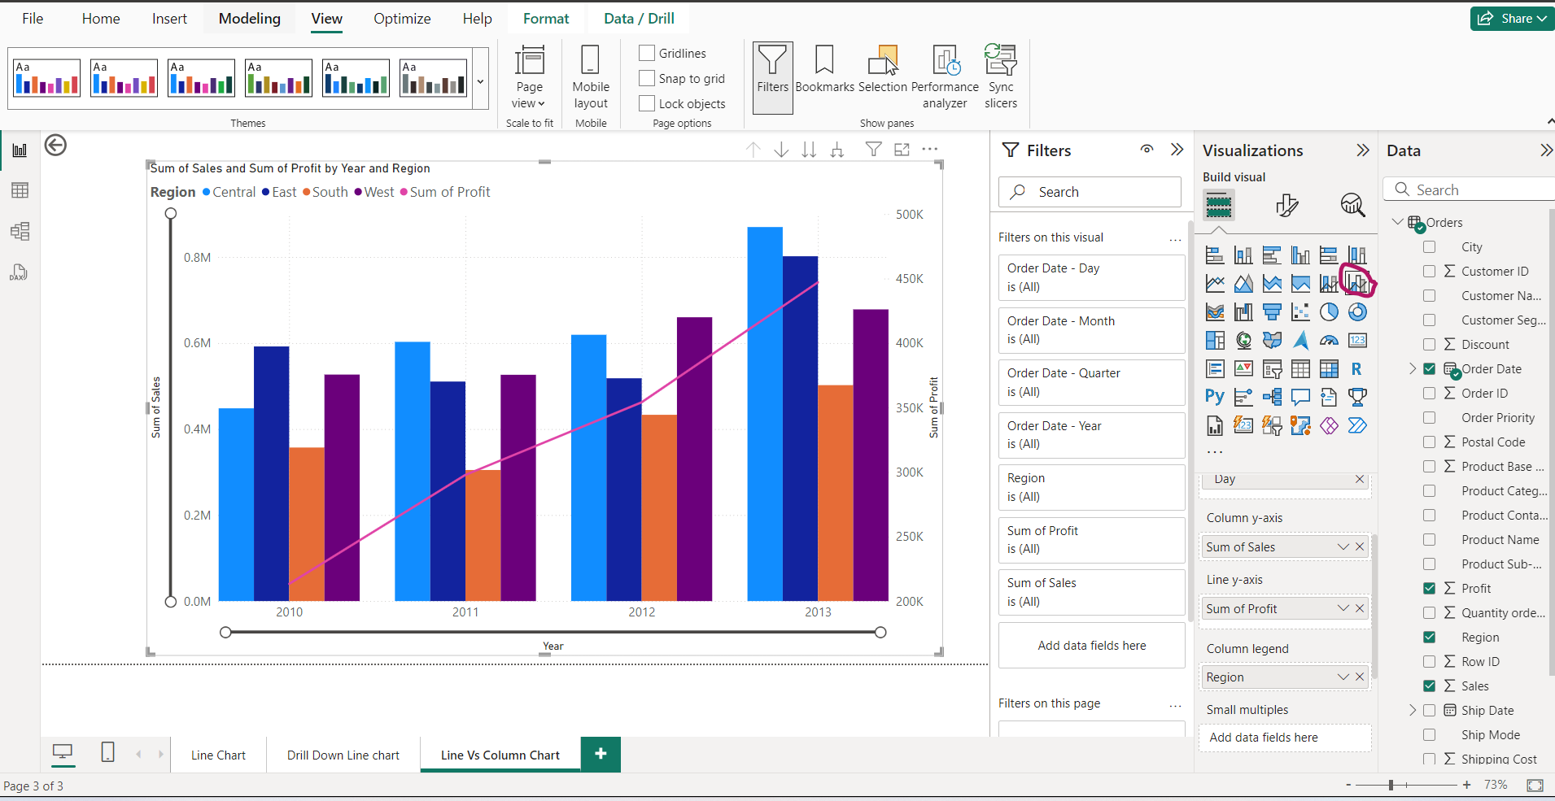
Line vs Clustered Column chart

Slide 27
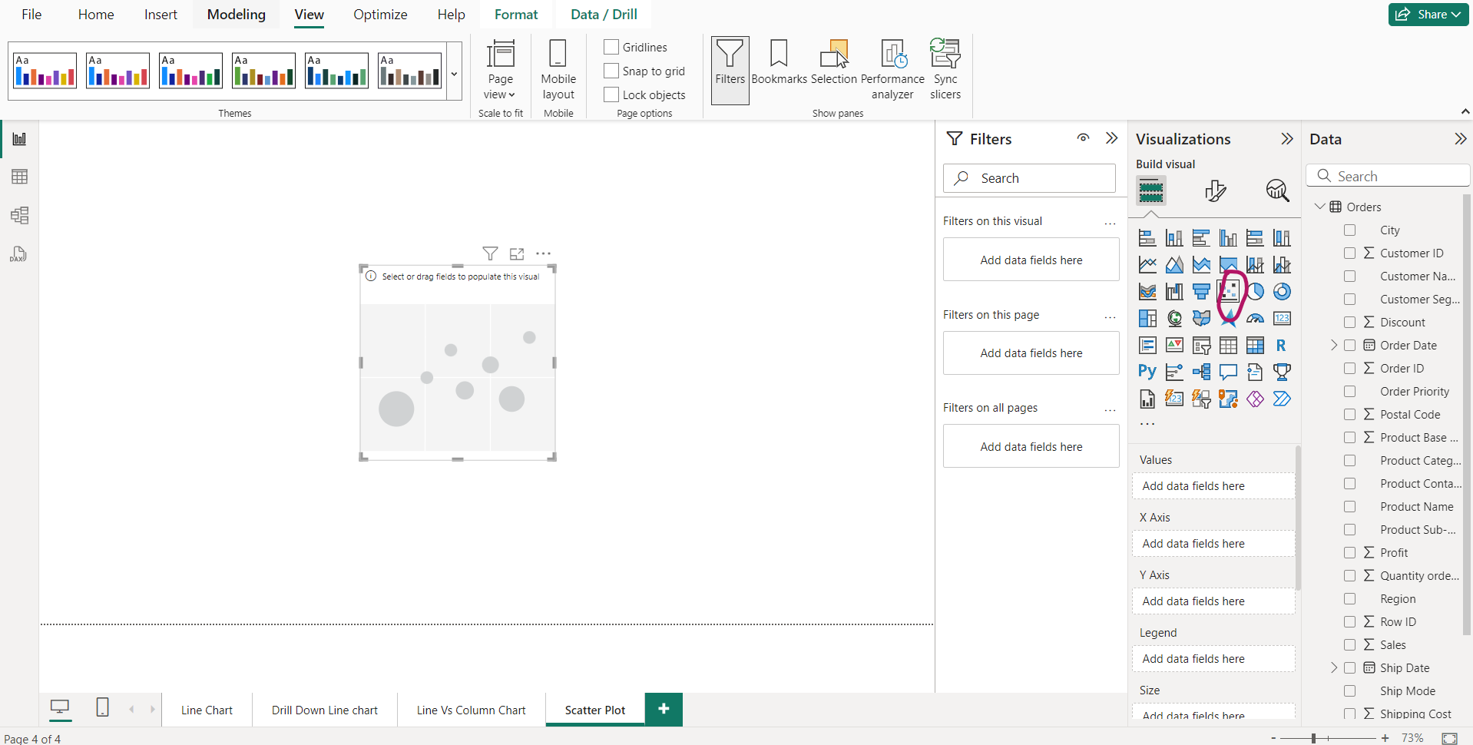
Scatter Plot(by default only animation chart in power BI)

Slide 28
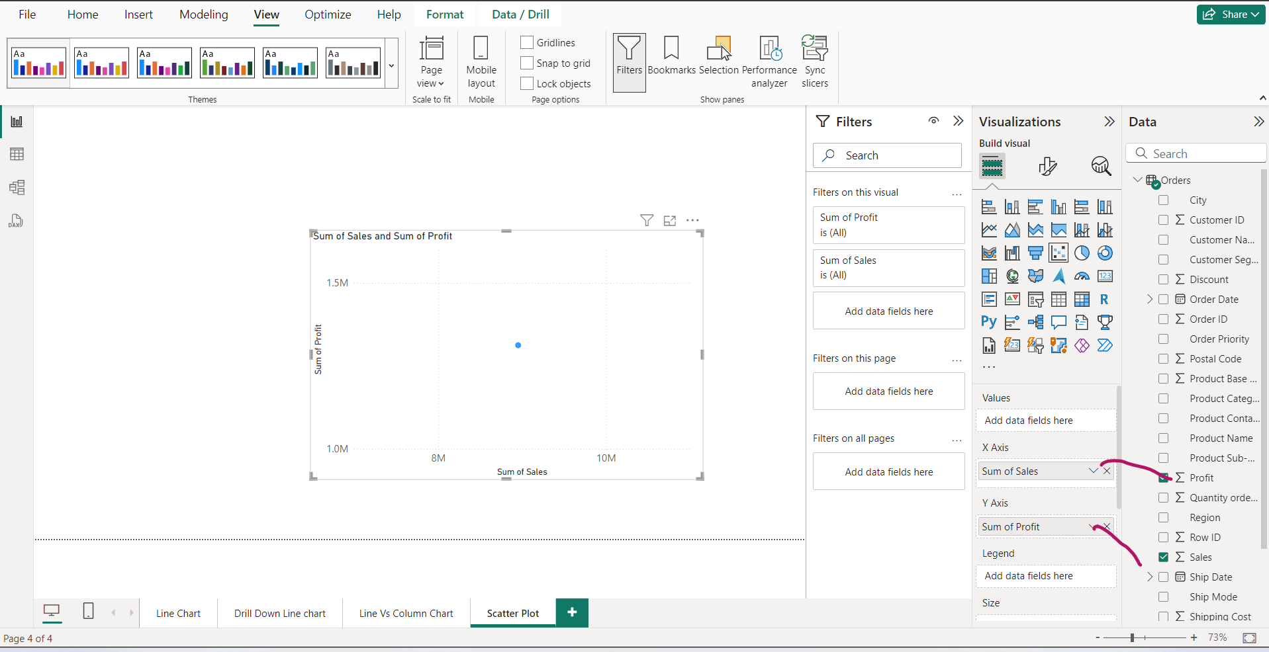
Single dot

Slide 29
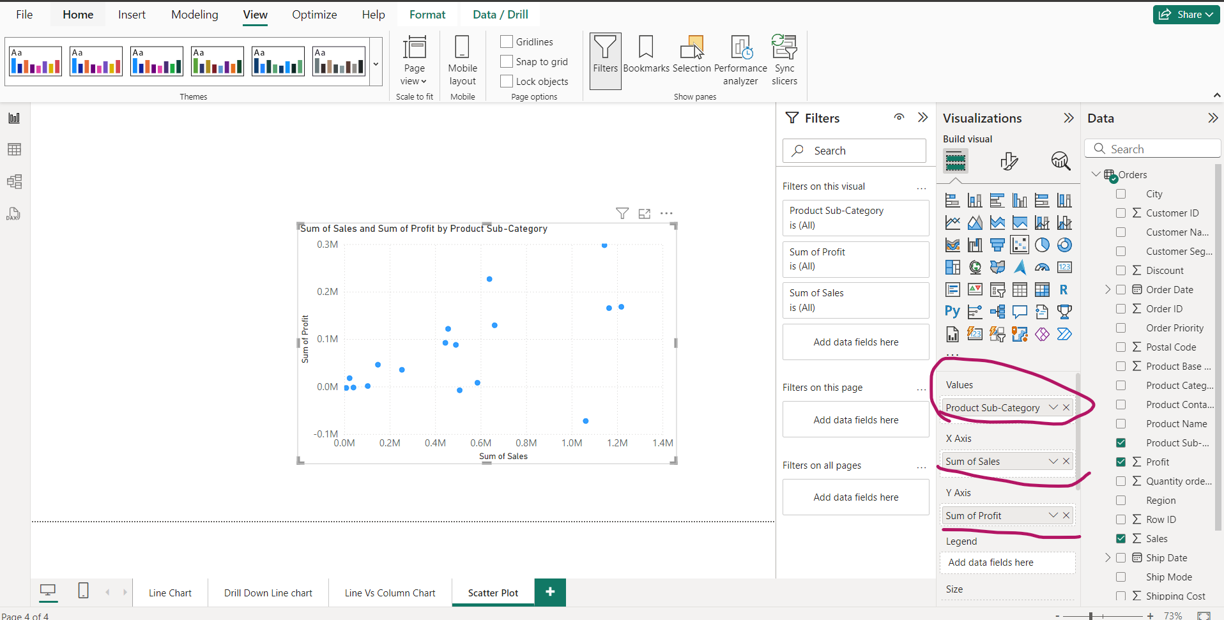
Sub category Profit-Sale Scatter plot

Slide 30
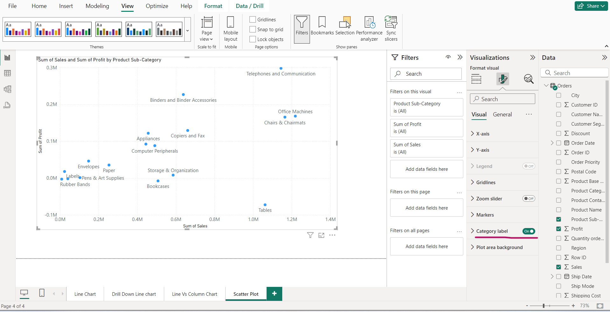
Scatter Plot – turn On “Category Label” option

Slide 31
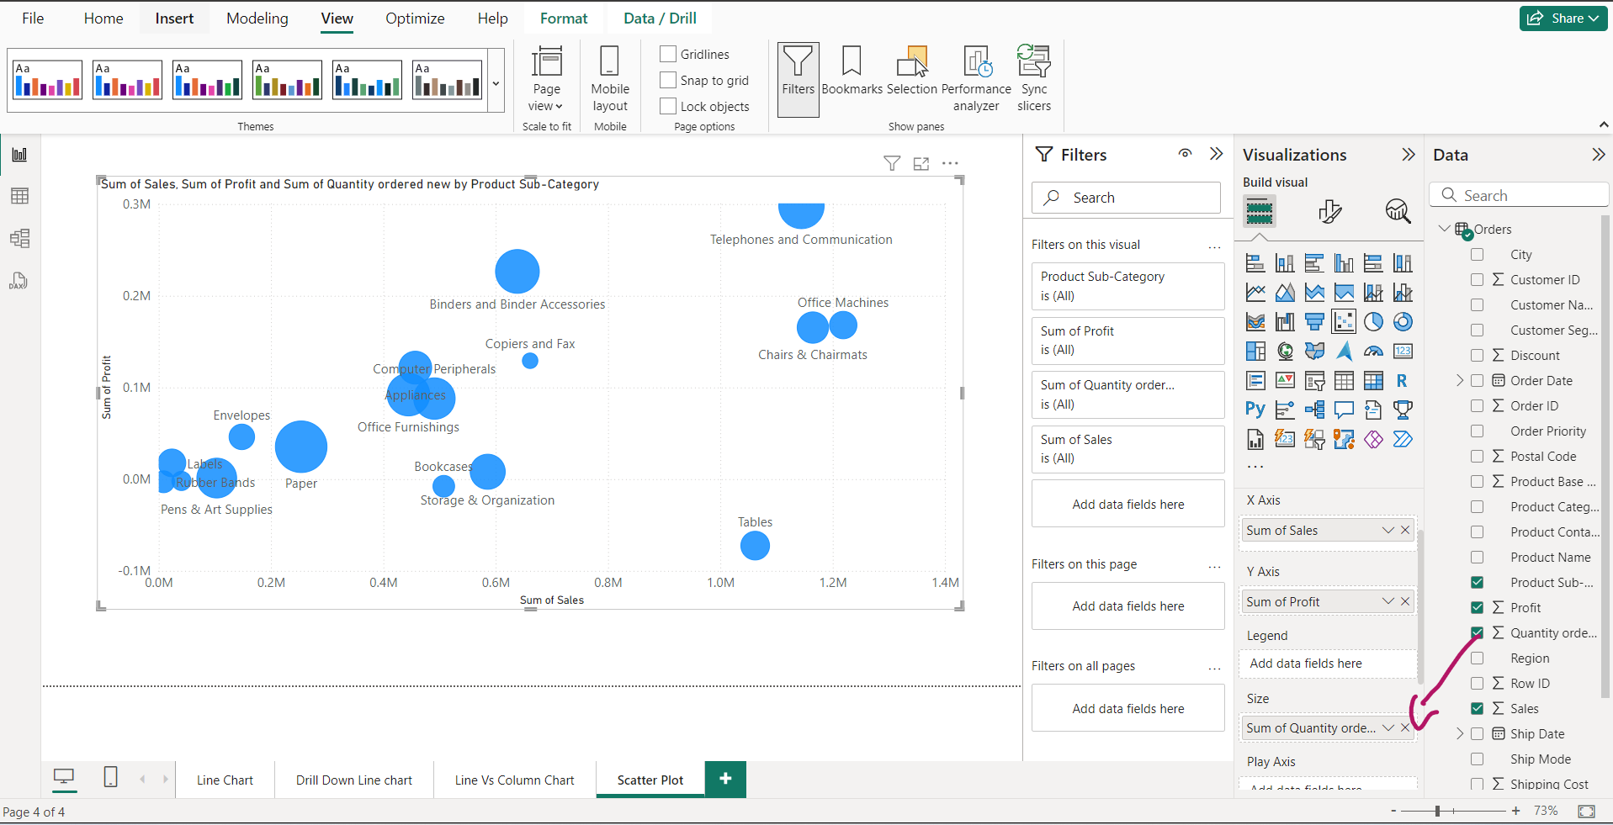
Sub category Profit-Sale Scatter plot Increase the bubble size by amount of Quantity order

Slide 32
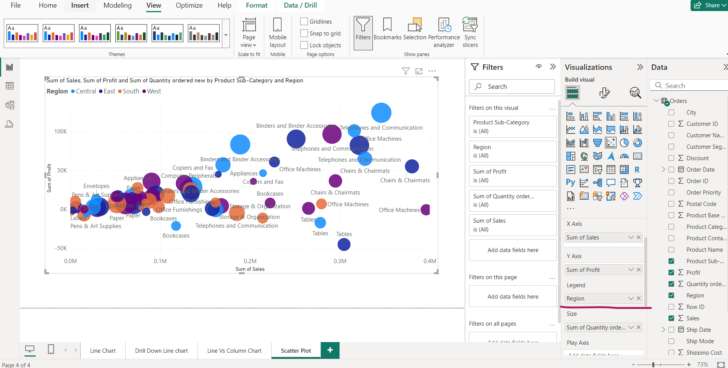
Sub category Profit-Sale Scatter plot, Region wise

Slide 33
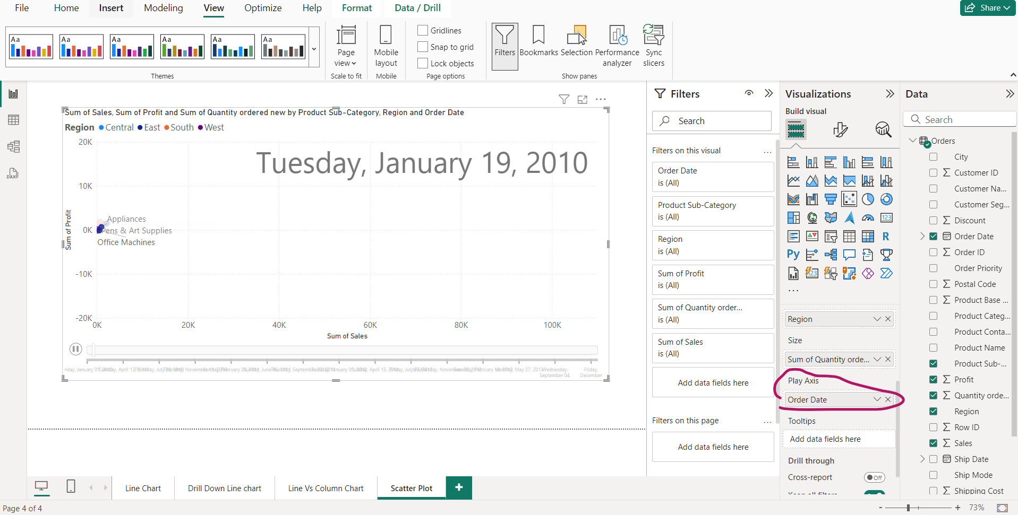
Scatter Plot – Play axis

Slide 34
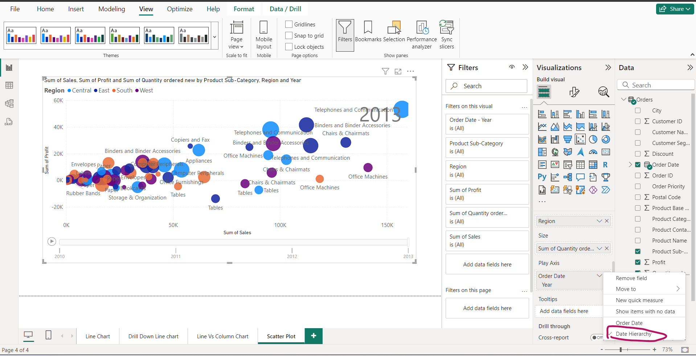
Scatter Plot – Play axis-> Yearly

Slide 35
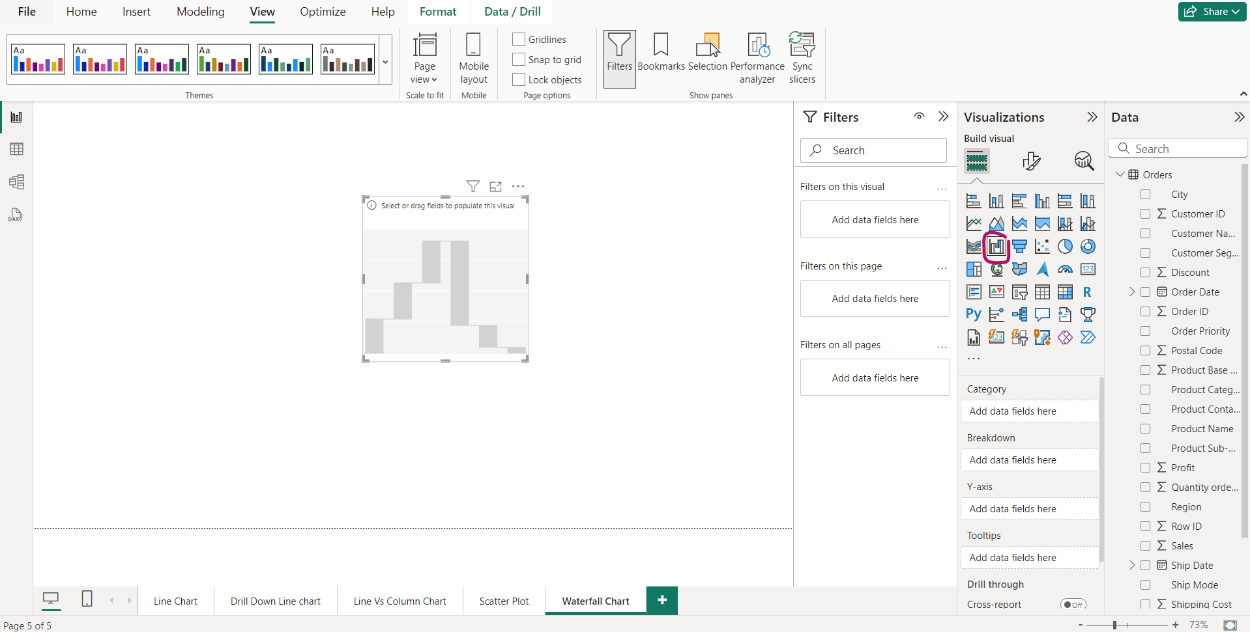
Waterfall Chart

Slide 36
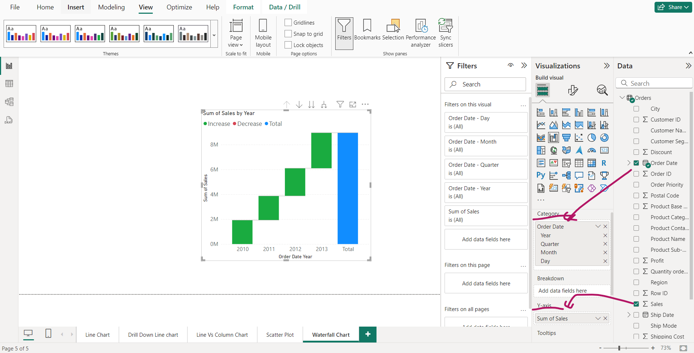
Water Fall chart

Slide 37
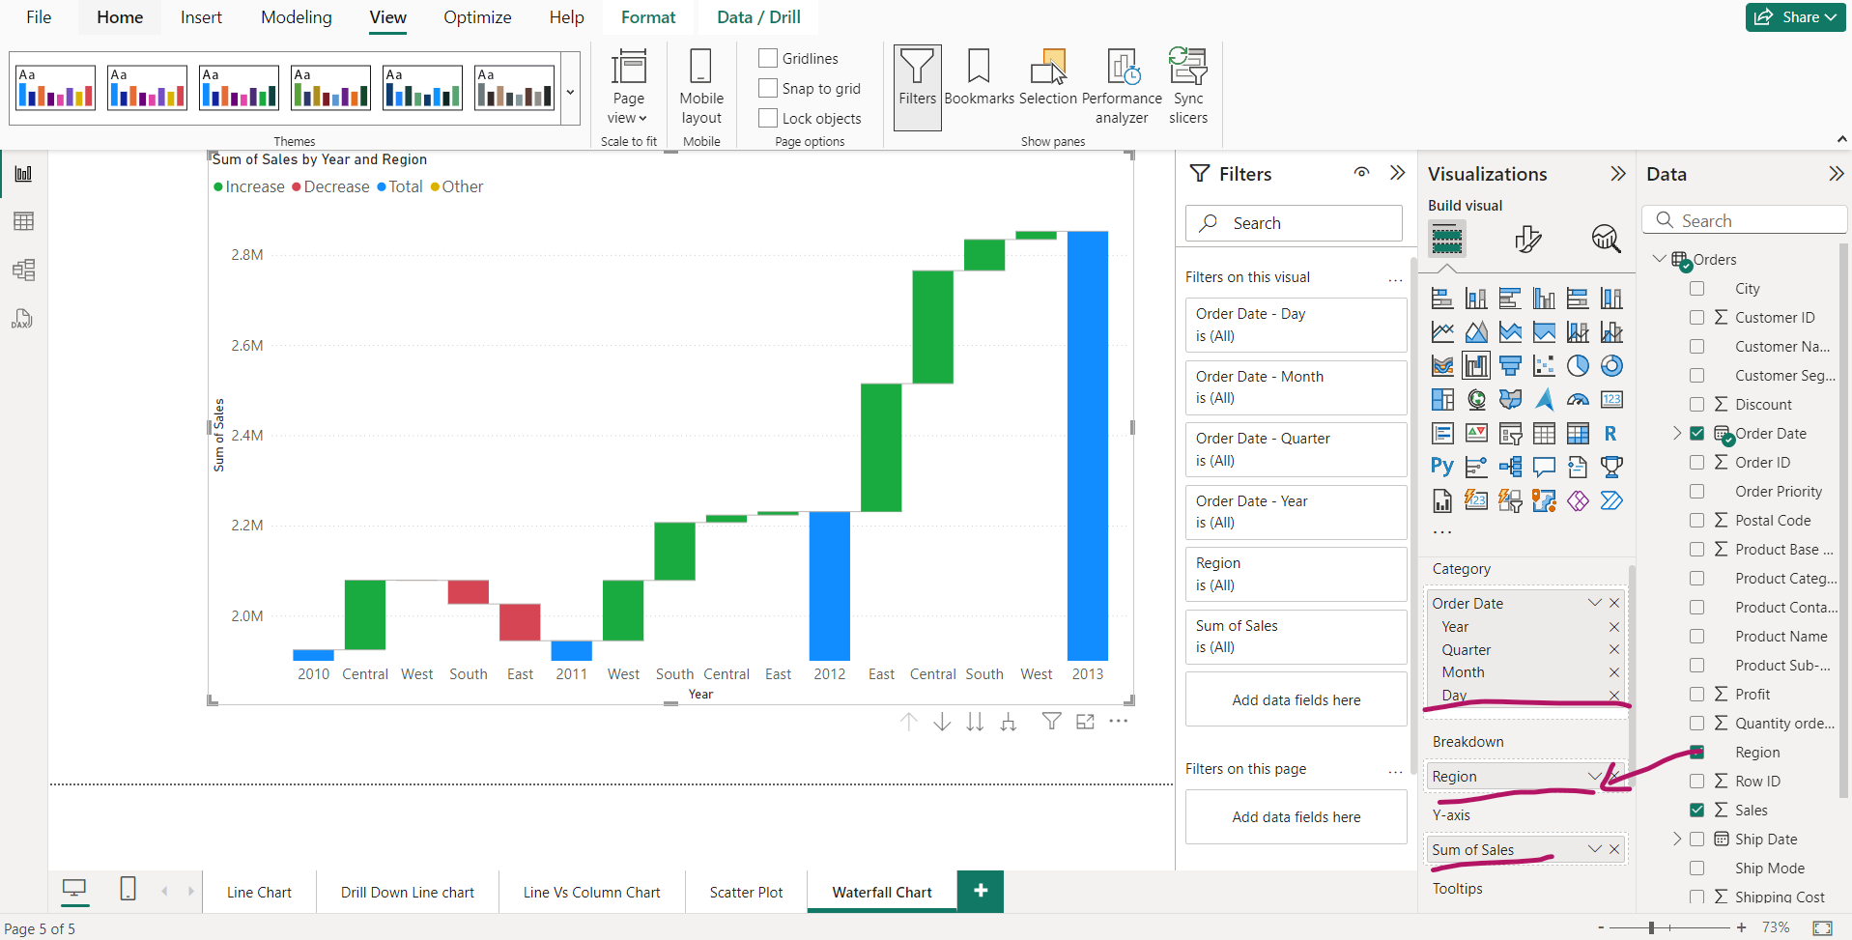
Water fall chart- Sales done with region wise break down

Slide 38
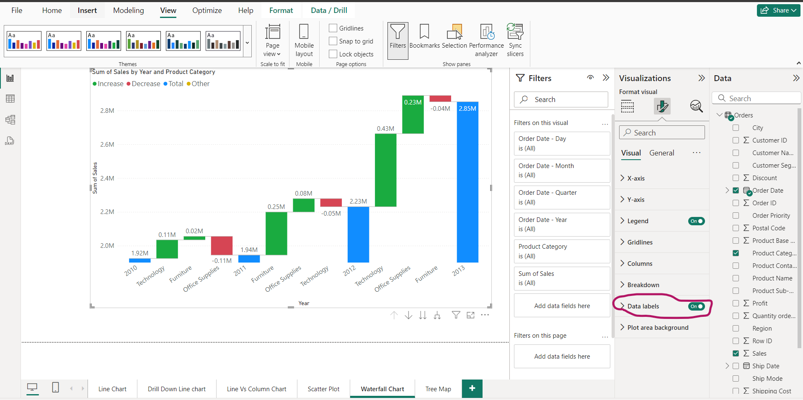
Water fall chart- Sales done with Product Category wise break down and Data Labels

Slide 39
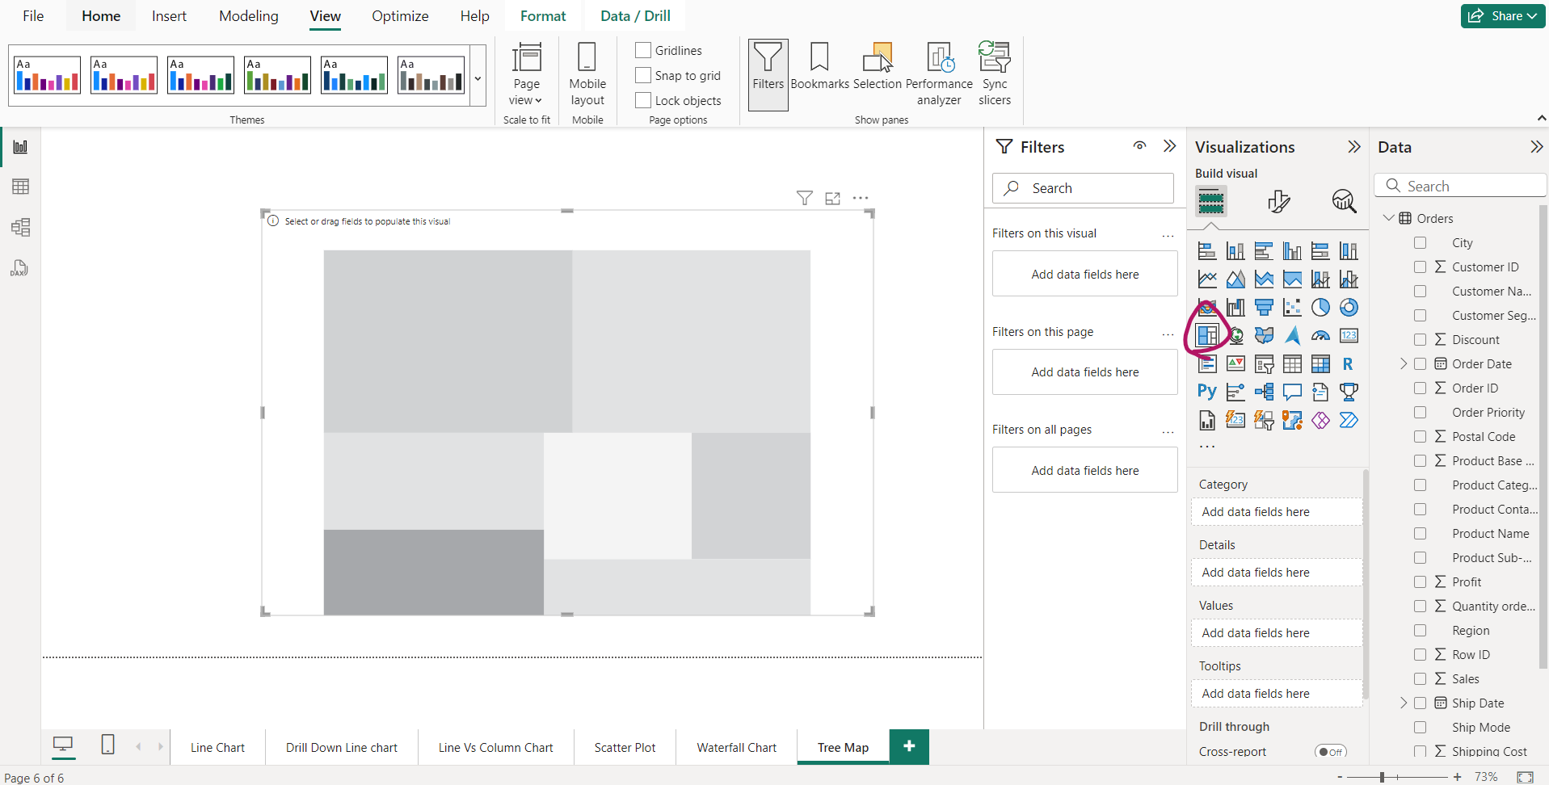
Tree Map

Slide 40
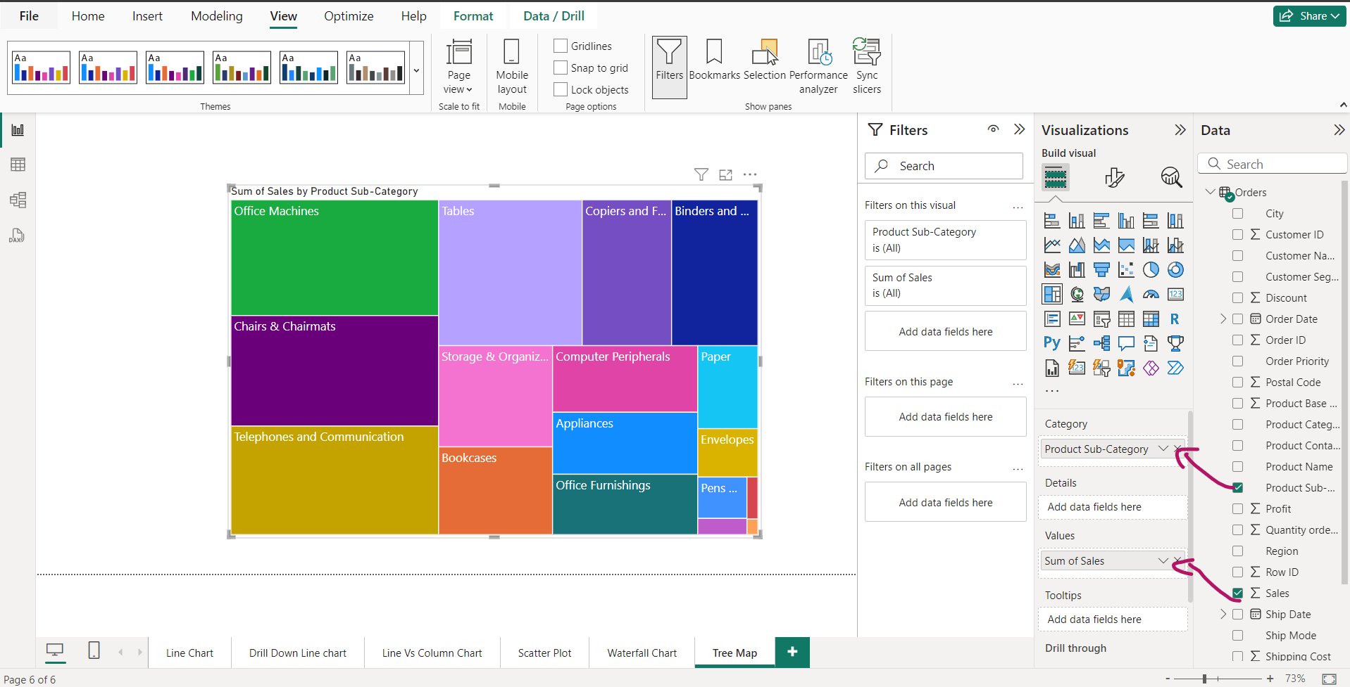
Tree Map- Product category wise Sales

Slide 41

Tree Map- Product category wise Sales in each region

Slide 42
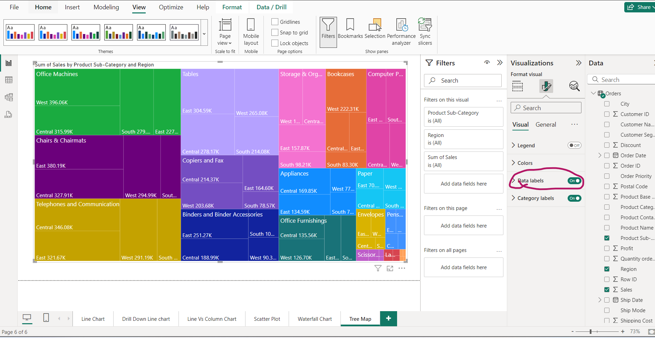
Tree Map- Product category wise Sales in each region with Data Labels

Slide 43
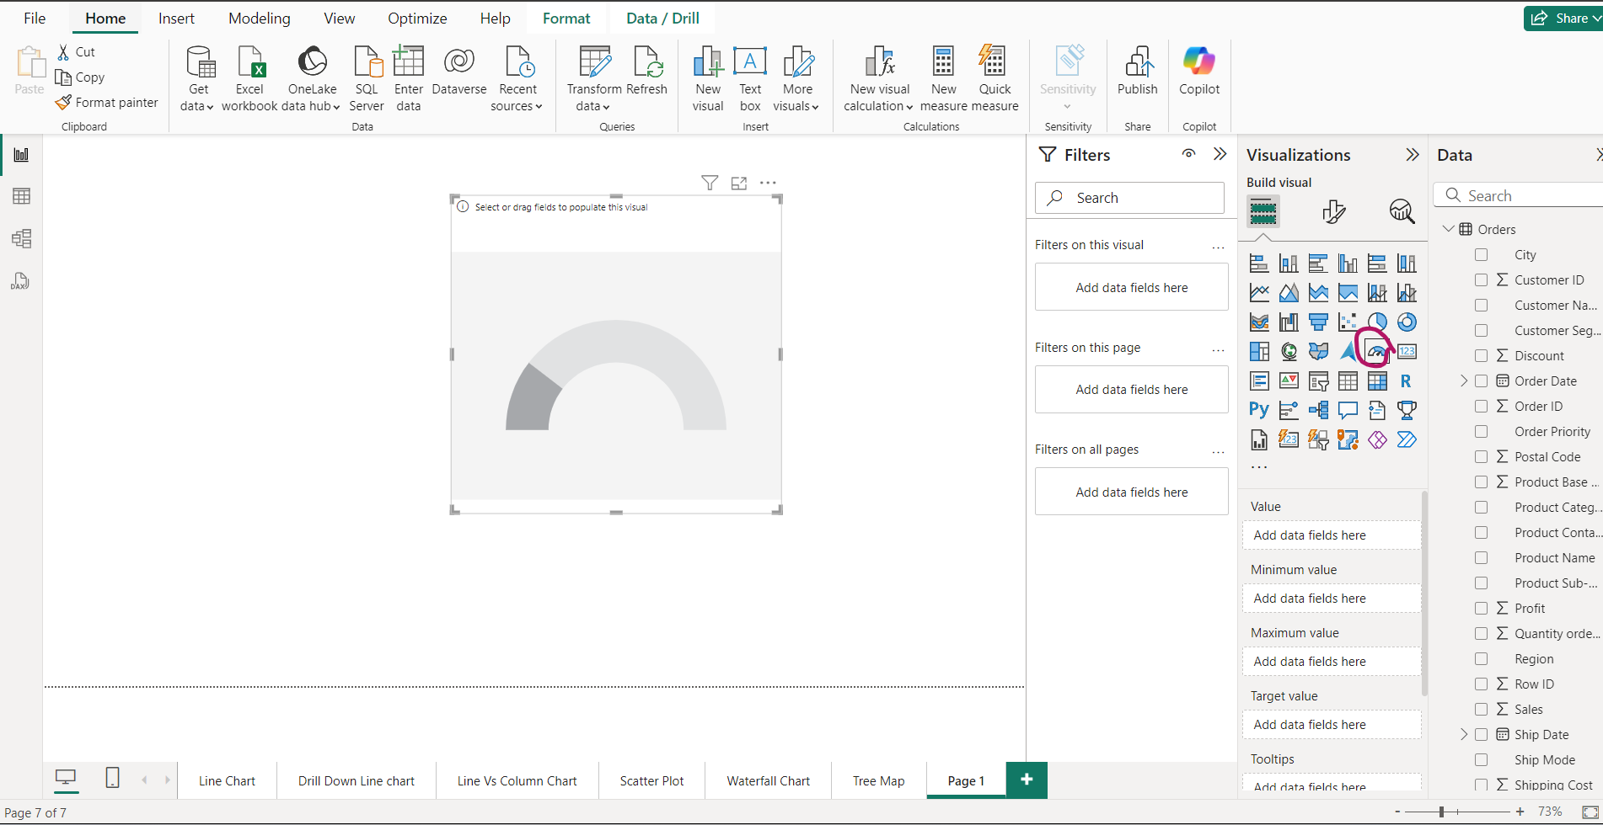
Gauge

Slide 44
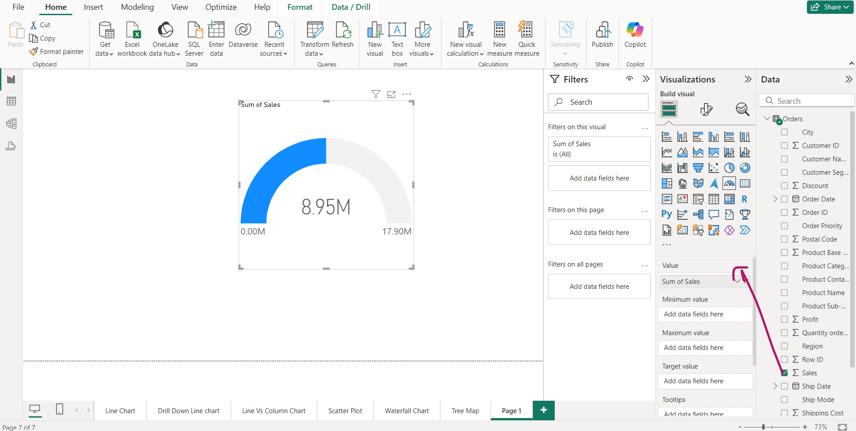
Gauge showing total sales

Slide 45
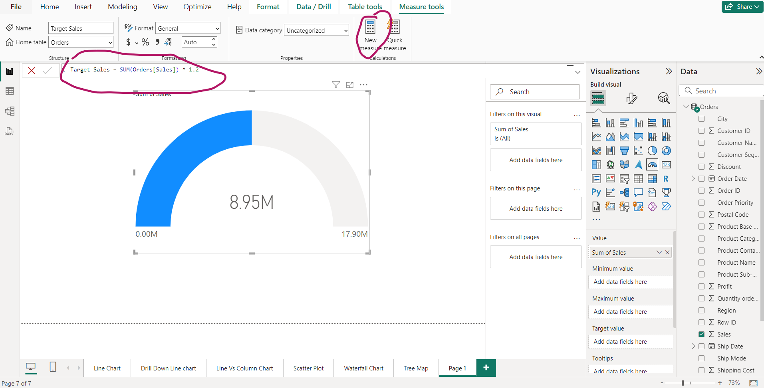
Gauge-Create a field of target sales to be compared with your original sales

Slide 46
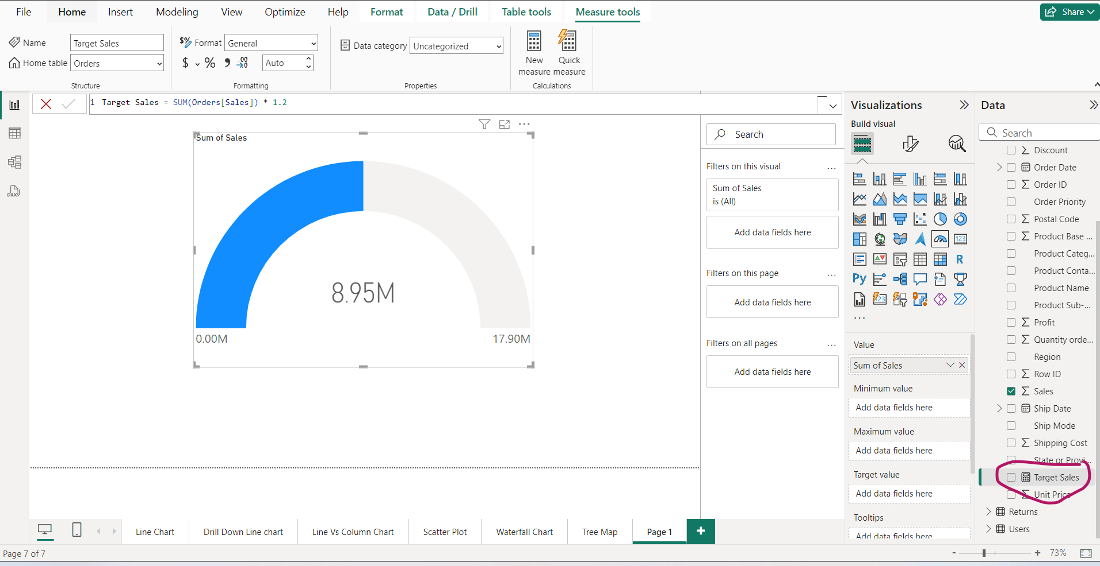
New Filed would be created in orders table -----→ Target Sales

Slide 47
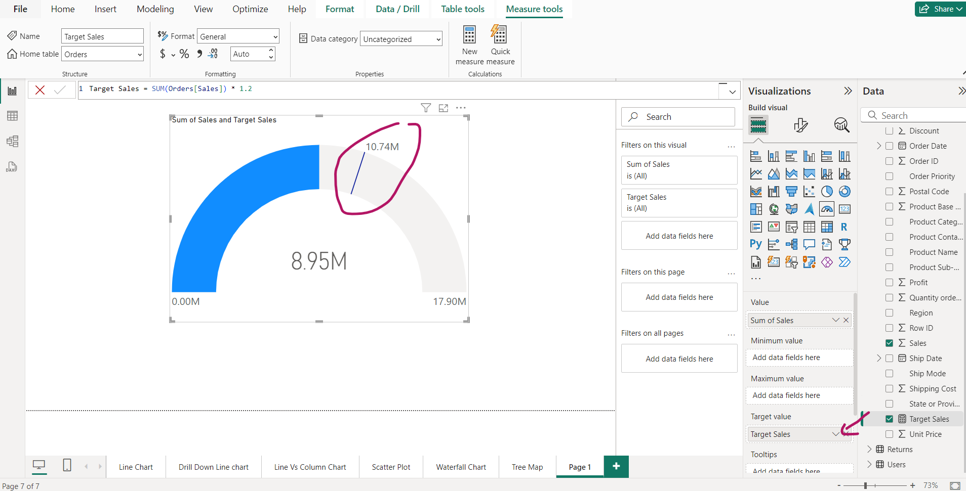
You have not achieved your target yet

Slide 48
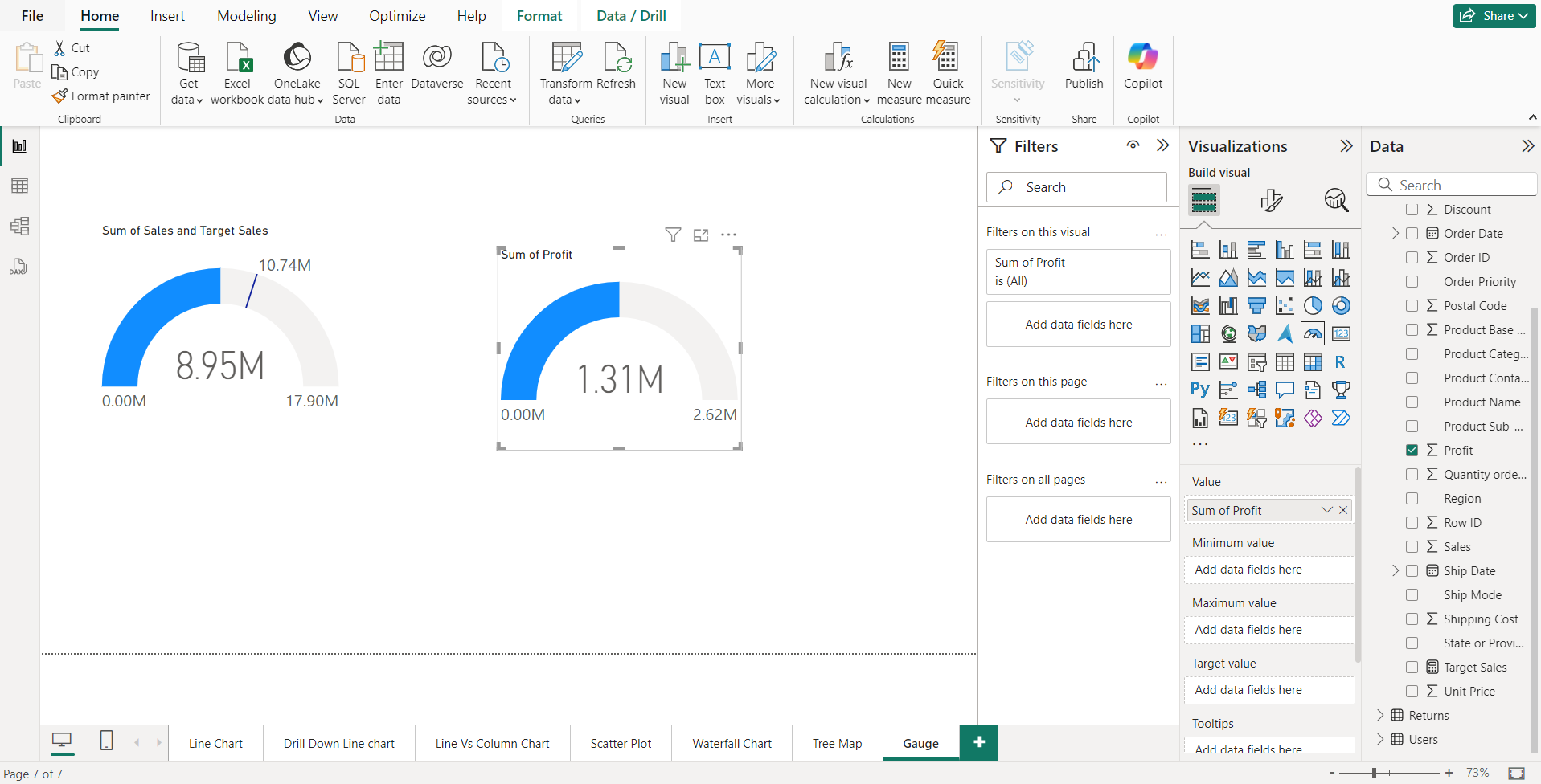
Gauge to measure sum of profit

Slide 49
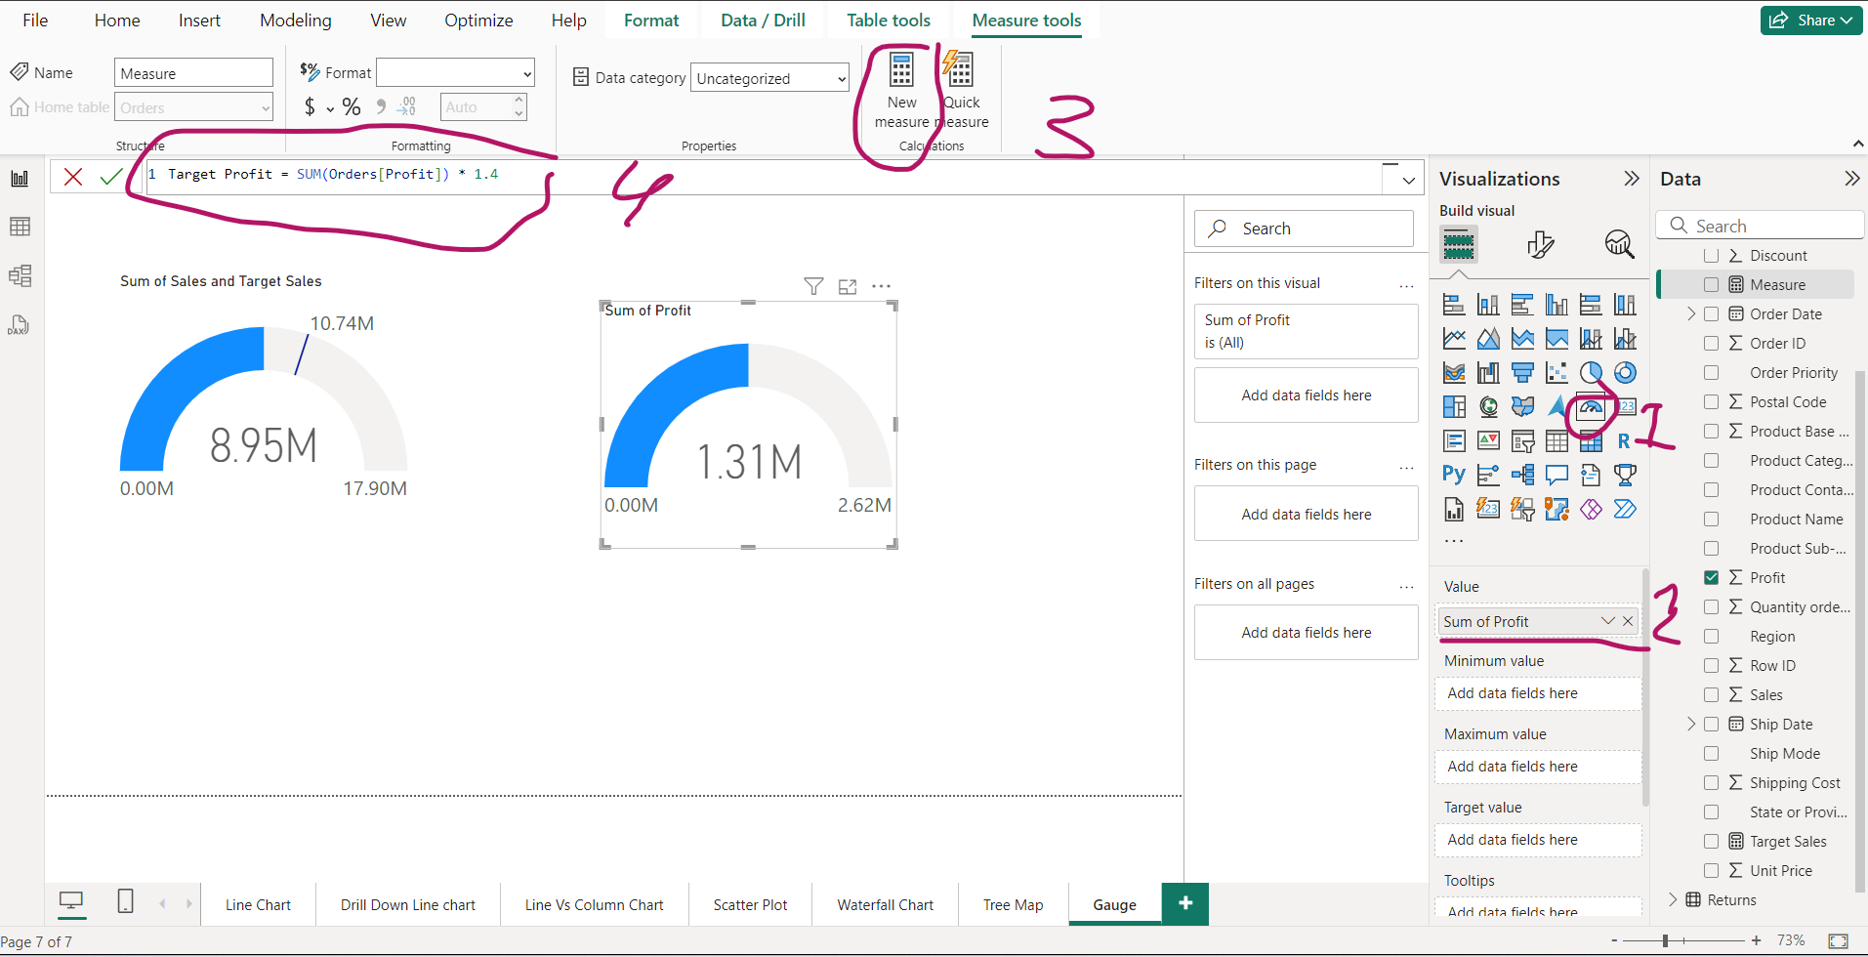
Create a taget profit field. Compare Actual profit with target profit

Slide 50
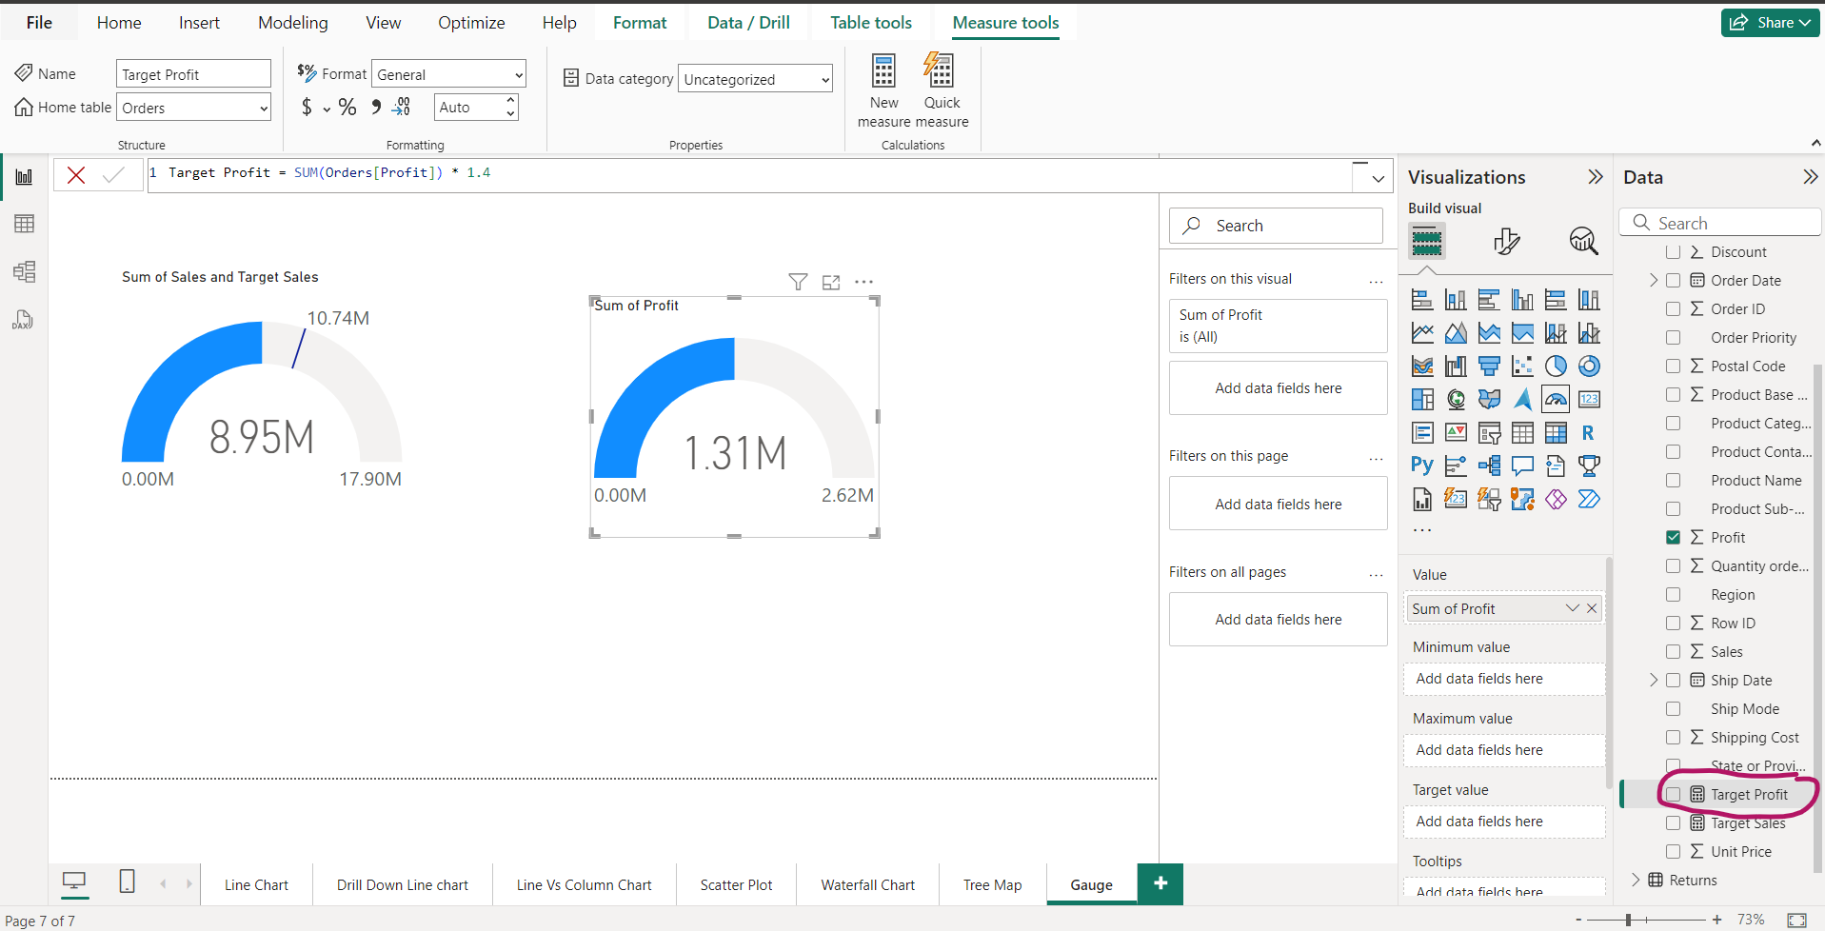
Field is created

Slide 51
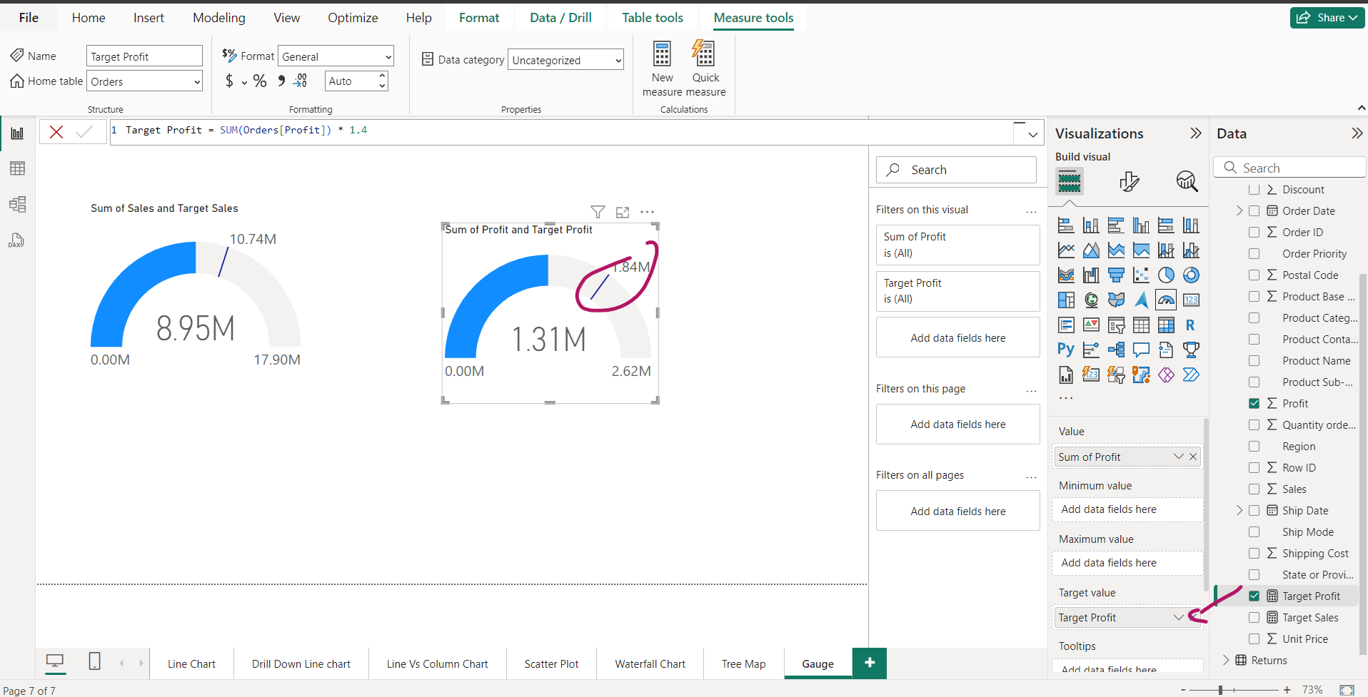
Compare Profit with target

Slide 52
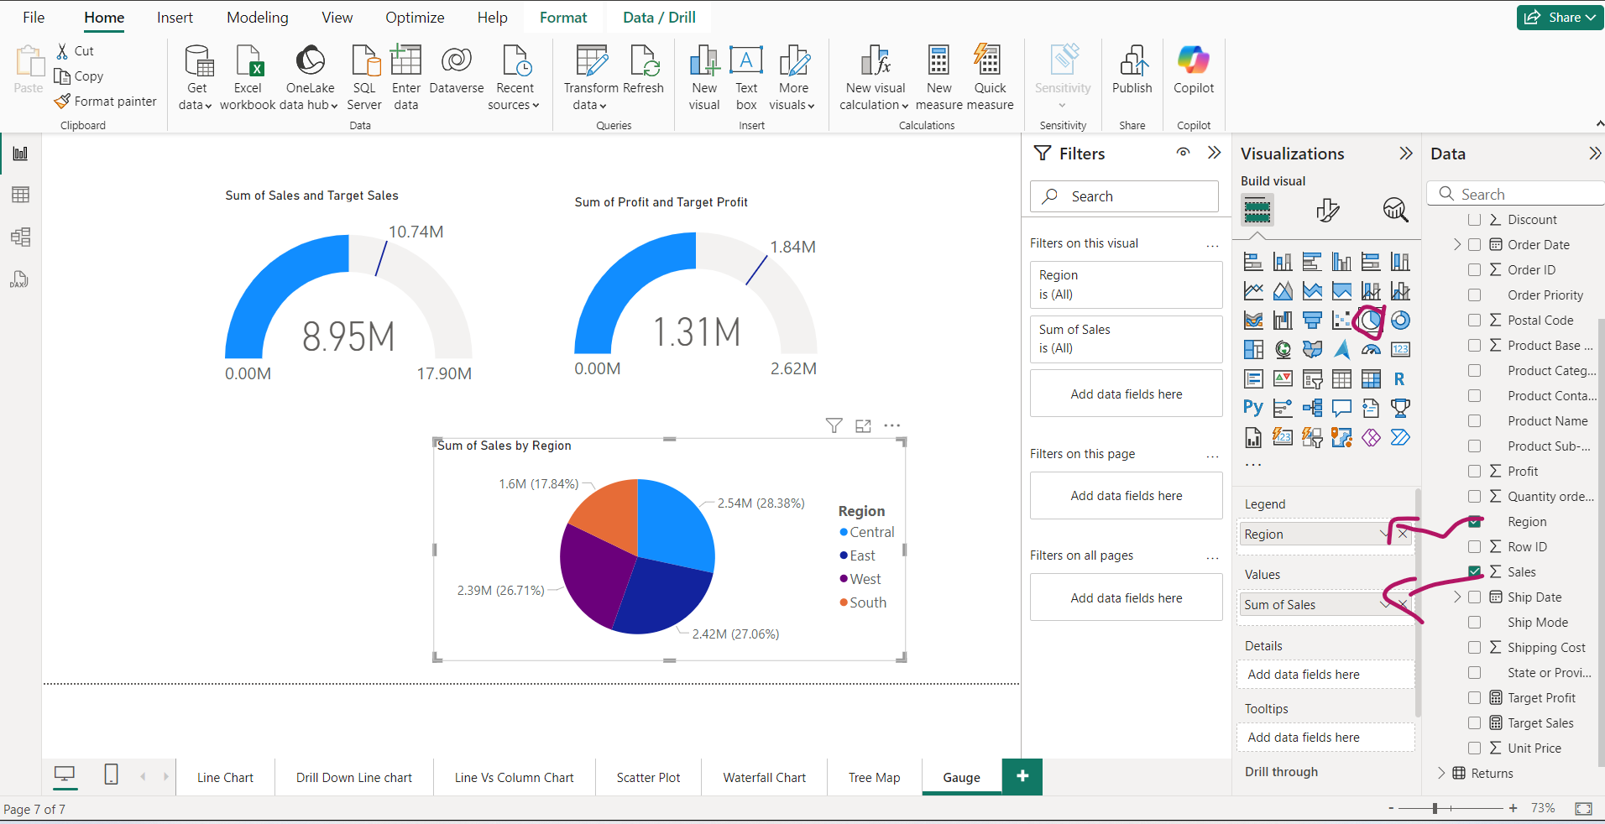
Pie chart and Gauge -> graphical relation

Slide 53

Number would change ->sales and Profit in central region

